Slide 1

DAY 2
Boot camp

Slide 2
DAY 2 Agenda
Topic | Topic Description | Estimated Time
Traps and Syslogs | Requirements for SNMP Trap and Syslog monitoring | 9 am – 9:30
Assets | How to create assets in your environment | 9:30 - 10:00
Views | Explore the views tab | 10:00 – 10:30
BREAK |  | 10:30 – 10:45
Event and Ticket Console Overview | Customizing, acknowledge, and clearing using the console Customizing, viewing, and creating using the console | 10:45 – 12:00
LUNCH |  | 12:00 – 1:00
Reports | Create and schedule reports within EM7 | 1:00 – 1:45
Run Book | Create an action from an automation to automatically have EM7 perform actions based on events. | 1:45 – 2:15
BREAK |  | 2:15 – 2:30
Dashboards | Create visual dashboards within the EM7 platform | 2:30 – 4:00

Slide 3
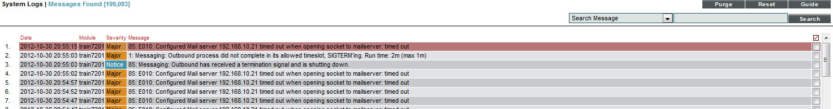
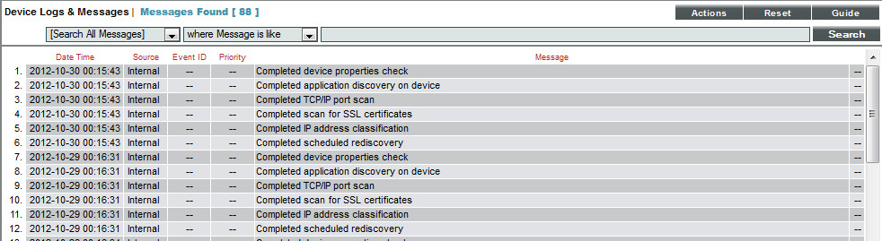
Traps & Syslogs

Slide 4

Objectives
What are SNMP Traps?
Client side SNMP Trap configuration
What is Syslog?
Client side Syslog configuration
Inbound message processing flow
Viewing Device Logs
Creating customer Event Definitions
Logging

Slide 5
What are SNMP Traps?
SNMP Trap - Asynchronous notification / alerts transmitted from a managed device to EM7.
SNMP Traps are defined in the vendor MIB
A destination address for where the traps are to be sent is required.
The major difference in SNMP Traps vs. SNMP is data collected via SNMP is polled and SNMP Traps are generated and sent out by the managed device on no defined interval.
SNMP Traps can be received by:
Data Collector
Message Collector
All-in-One
SNMP Traps by default are sent from the managed device to EM7 on UDP port 162
Logging

Slide 6
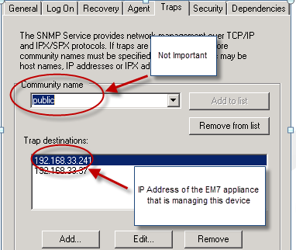
Configuring SNMP Traps
Device side configuration
Install or verify the installation of the SNMP Service
Configure the Trap Destination as the IP Address of either the All-in-One, Data Collector or Message Collector depending on which appliance is managing that device
Restart the SNMP Service
For other device types (Linux, Network, Storage, Security, Power Management) follow the vendors procedures to configure trap and syslog destinations.
Logging

Slide 7
What is Syslog?
Syslog is another Asynchronous message type that is generated from a managed device and can be sent to EM7.
Syslog has defined logging levels that can allow for base lining configurations
A destination address for where Syslogs are to be sent is required.
The major difference in Syslog vs. SNMP is data collected via SNMP is polled and Syslog messages are generated and sent out by the managed device on no defined interval.
Syslog messages can be received by:
Data Collector
Message Collector
All-in-One
Syslog messages by default are sent from the managed device to EM7 on UDP port 514
Logging

Slide 8
Configuring Syslog
Microsoft servers will require the SNARE agent (open source) to send Event Viewer messages to EM7
Unix servers will require the syslog.conf file to be configured to send Syslog messages to EM7
Networking Devices will require syslog configuration as well
For other device types (Linux, Network, Storage, Security, Power Management) follow the vendors procedures to configure trap and syslog destinations.
Logging

Slide 9
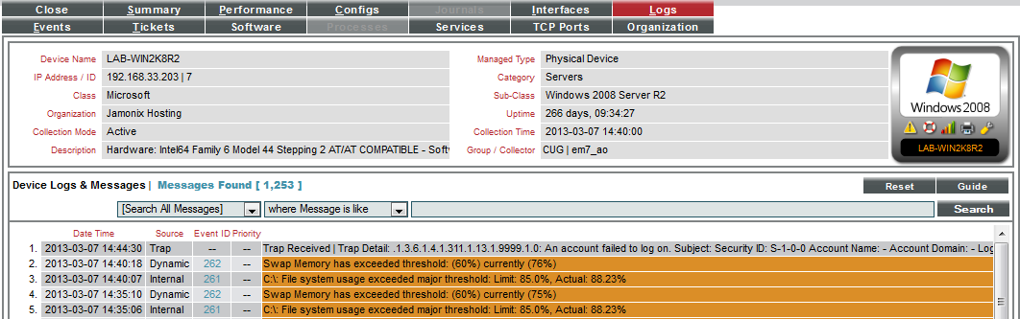
Viewing Device Log Messages
Device Reports > Logs
Managed device initiated message sent to the EM7 Data Collector
Written to the device log
If the Syslog or Trap also matches an event definition, it creates an event (grey if it is just a message, event severity color if the message matches an event definition)
Logging

Slide 10
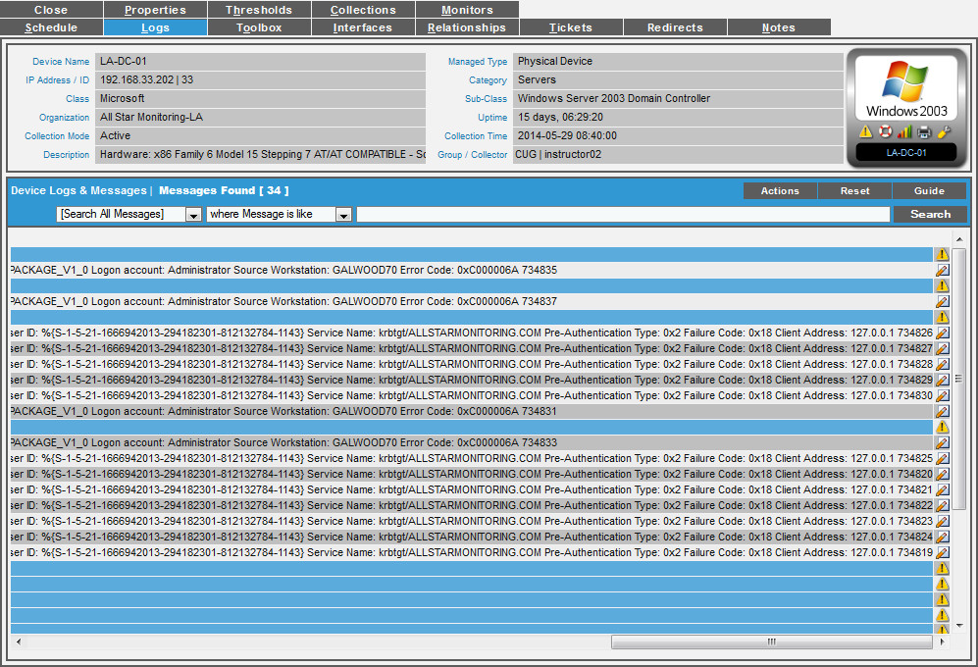
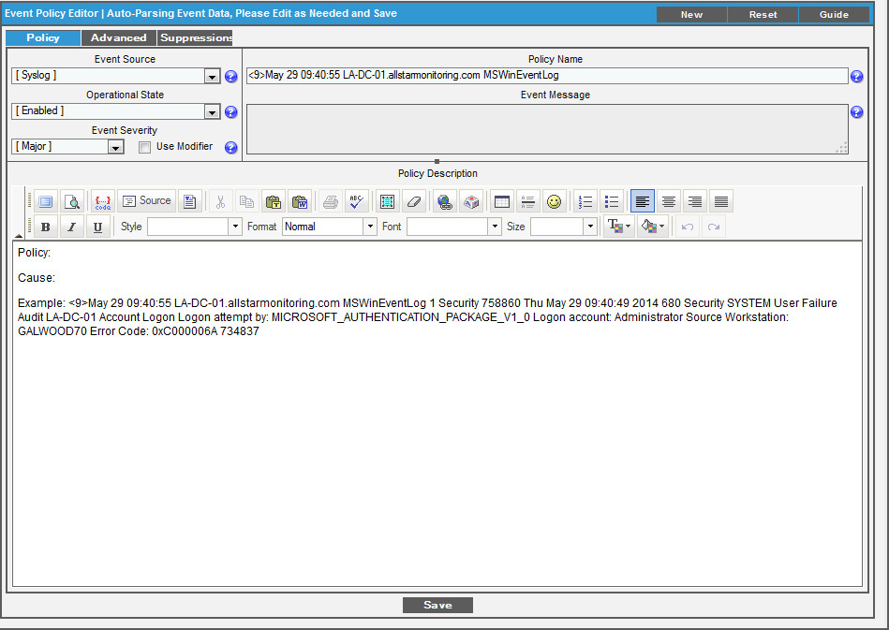
Converting log messages into Events
Device Properties > Logs Tab > Notepad Icon
Log file icon opens the Event Editor
Logging

Slide 11


Resources and Questions
For more information:
Messaging Collection in EM7
Guide button within EM7
All manuals are located on the Customer Portal: http://portal.sciencelogic.com
Logging

Slide 12

Lab: Syslog
Review a Trap Message on the Device Summary > Logs tab
Go to Registry
Go to the Device Summary (Chart) of 192.168.33.203
Review the Logs tab for failed authentication messages
Review a Trap Message on the Device Summary > Logs tab
Go to Registry
Go to the Device Summary (Chart) of 192.168.33.203
Review the Logs tab for failed authentication messages
Use the [Notepad] icon to open the Event Manager
Review the new event definition and change the Log Message field to “Training Lab Event”
[Save]
Logging

Slide 13

Assets

Slide 14
Objectives:
What is an Asset?
Create and View Assets
Asset Record Manager
Asset Record Events
Asset Record Reports
Delete Asset
Assets

Slide 15
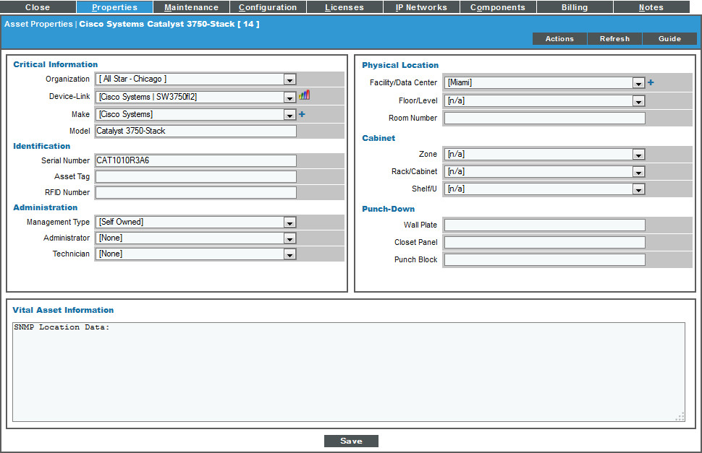
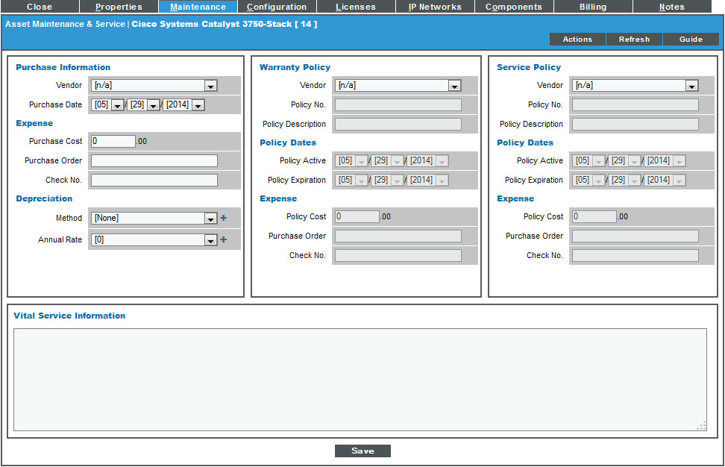
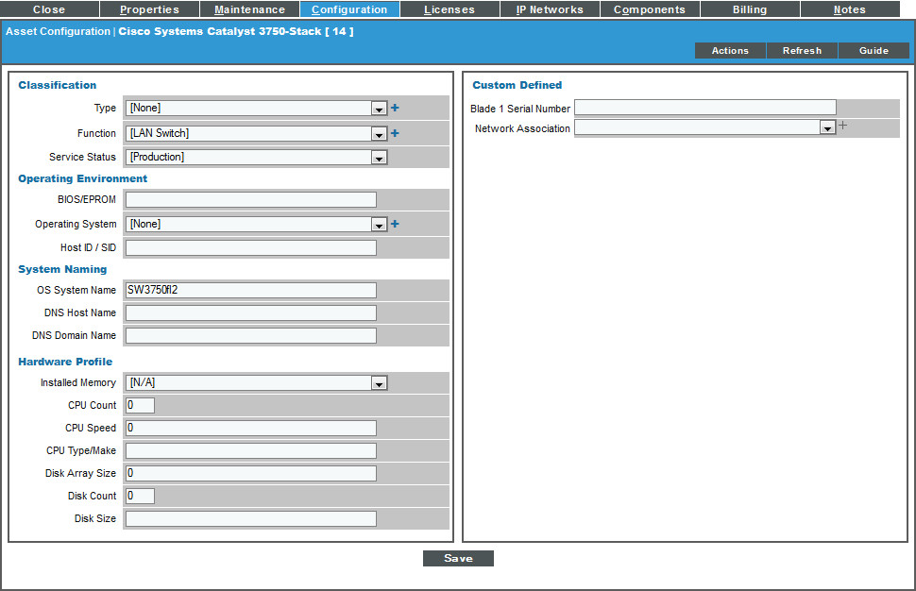
What is an Asset Record?
An Asset Record is a collection of information including name, make, model, serial #, physical location, warranty info, hardware info, and the ability to place custom fields to meet specific needs.
An Asset record can be a device that is monitored within EM7 or a piece of software, license, or a piece of furniture.
Information available based on SNMP, can be auto-populated through discovery if enabled through EM7, and updated with dynamic applications or manually entered. Nightly Discovery then updates the records.
Automatically trigger events based upon asset information and changes
Generate asset reports directly from the management platform.
Assets

Slide 16


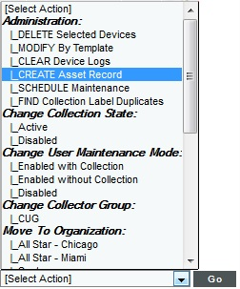
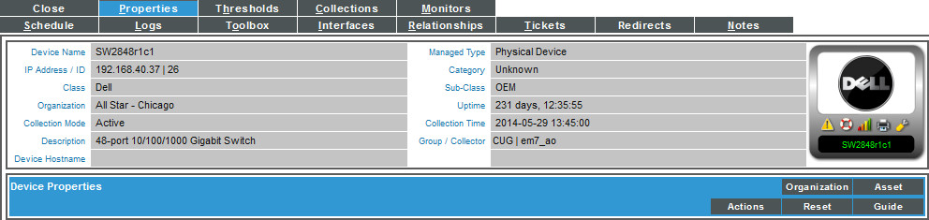
Asset Record: Create
Registry > Devices > Device Manager > Create
- Asset Exists
4 ways to create Asset Records:
Device Manager – Select gray tag icon
Device Manager > Select Actions create Asset Record (Single/Bulk)
Device Administration > Properties select the Asset button
Assets > Asset Manager
- Asset Doesn't
Exists
Assets
Notes:
Go to Registry > Devices > Device Manager to navigate to the Device Manager page.
Find the device for which you want to view an asset record for.
Click on the Asset icon.
If the Asset is grayed out, it means an asset record has not been created for the device.

Slide 17
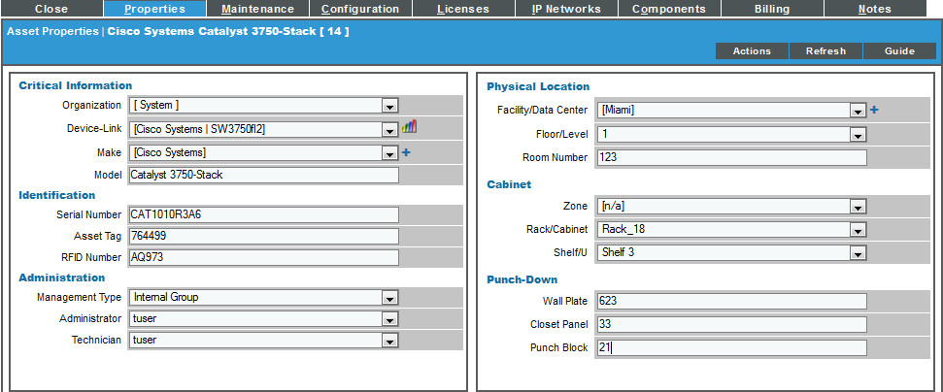
Asset Record Manager: Properties
Registry > Assets > Asset Manager > Wrench icon > Properties Tab
Properties page displays overview information about an asset
Model
Serial Number
Asset Tag
Administrator
Facility/Data Center location
Rack/Cabinet
If you see a plus-sign (+) next to a field, you can add an additional entry to the drop-down list. This entry will then be available as a choice for all subsequent users.
Assets

Slide 18
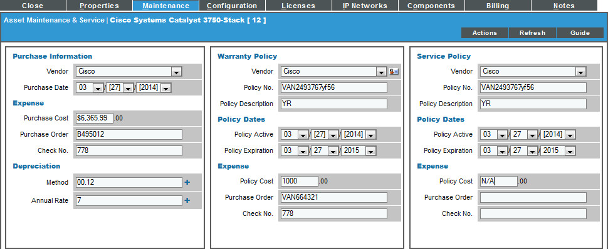
Asset Record Manager: Maintenance
Registry > Assets > Asset Manager > Wrench icon > Maintenance Tab
Asset Warranty & Service policy expiration setting allows for an event to occur when an asset is about to or has expired
Vendor Information is obtained from Registry > Accounts > Vendors
Warranty and Service Expiration policy settings. To configure these settings you must have a vendor selected
System > Settings > Behavior > Asset Warranty Expiry specifies a threshold for when EM7 should spawn an event for an asset's warranty or service policy that is about to expire. The choices range from 1 day to 9 months.
Assets

Slide 19
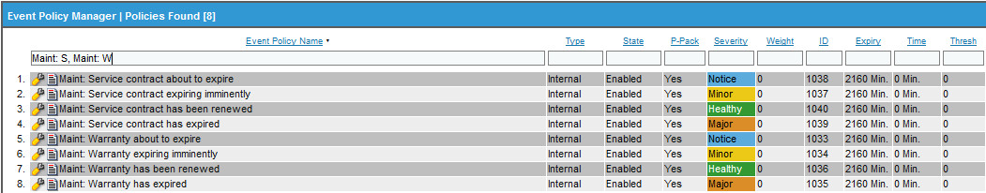
Asset Record Events
Registry > Events > Event Manager
There are 4 internal events for Maintenance Service and Warranty expiration.
About to expire – This notice severity event is generated based on the Asset Warranty Expiry setting in System > Settings > Behavior > Asset Warranty Expiry
Expiring Imminently – This minor severity event is generated when an Asset Record is within 7 days of its Service or Warranty expiration date
Has Expired – This major severity event is generated once the Asset Record has exceeded its Service or Warranty expiration date
Has been renewed - This healthy severity event is generated when an Asset Record was within the Expiry threshold and now has been renewed
Asset Warranty Expiry check is run once a day (maint_daily.py)
Event Polices are set for 2160min (36 hours) expiry since the check runs just once a day
Assets

Slide 20
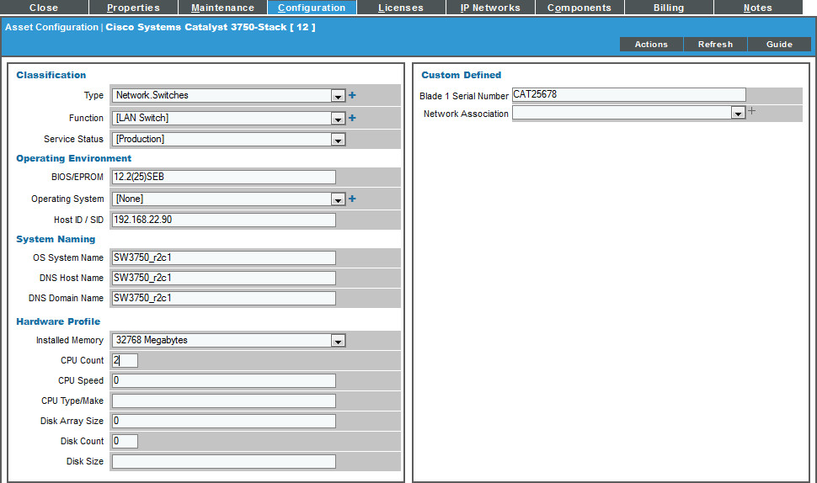
Asset Record Manager: Configuration
Registry > Assets > Asset Manager > Wrench icon > Configuration Tab
Configuration tab has technical information about the hardware and system configuration.
Displays Function
BIOS/EPROM
Host ID
DNS info
Installed Memory
CPU Count, type, speed
Disk size
Custom Defined fields are Form Fields created for Asset Records and appear under the Configuration Tab
Assets
Notes:
When possible, ScienceLogic can automatically populate fields in each asset record. Included in Assests:
The name, make and model of a device.
The serial number of a device.
Function and status of a device.
Networking information, like host ID, IP address, or DNS server for the device.
Physical location of the device.
Description of the network interface.
Vendor information for the device, including PO or check number, warranty policy and service policy.
Hardware information like the amount of memory, CPU, and BIOS or EPROM version.
Description of each hardware component (if applicable).
Description of installed software (if applicable).

Slide 21
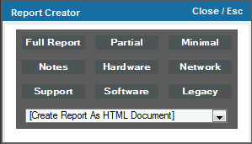
Asset Record: Reports
Registry > Assets > Assets Manager
Displays Function
BIOS/EPROM
Host ID
DNS info
Installed Memory
CPU Count, type, speed
Disk size
Assets

Slide 22
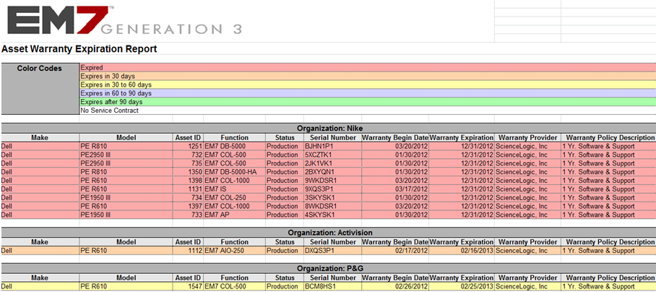
Asset Record: Reports
Reports > Quick Reports
Displays Function
BIOS/EPROM
Host ID
DNS info
Installed Memory
CPU Count, type, speed
Disk size
Assets

Slide 23
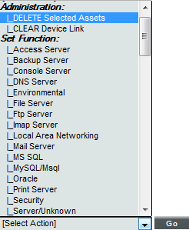
Asset Record: Delete
Registry > Assets > Asset Manager
Tip – Deleting an Asset Record that has a “device-link” to a Device Record will not delete the Device Record.
Select the Checkbox next to the Asset
Select Action: Delete Selected Assets
Click [Go]
Assets

Slide 24

Asset: Pro Tip
An Asset record is an independent record.
What is a “Device-Link”?
A device-link is formed when an Asset record is created from a managed device or component.
An Asset record can be linked to a single device record and viewed as “device-link” within the Asset Manager.
An Asset is an element that is associated with an organization. This organization can be different from the “device-link” device record.
When deleting an Asset record that has a “device-link” the device record is not deleted and vice versa.
Assets

Slide 25
Resources And Questions
For more information:
Asset Management and Vendors Manual
Guide Button within EM7
All manuals are available on the Customer Portal:
http://portal.sciencelogic.com
Assets

Slide 26
Asset Lab Goals
Create an Asset from the Device Registry
Configure Maintenance Expiration information
Configure Service Status
Add a License to the record
View the Warranty Expiration Report
Assets

Slide 27
Lab: Assets
Create an Asset from the Device Manager
Go to Registry > Device Manager
Select the CHI-WEB-01 device and click the tag icon
For Asset Tag fill in “SN84749”
For Facility/Data Center click the red + sign, put you cursor in the text area and enter “Chicago Data Center”
For Floor/Level choose 1
Select Rack/Cabinet of Rack_12
Click [Save]
Assets

Slide 28
Lab: Assets
Enter Maintenance Information for the Asset Record
Click [Maintenance] in the Asset Record CHI-WEB-01
In the Warranty Policy area use the Vendor dropdown to choose “ScienceLogic, Inc”
Select a Warranty Policy Policy Expiration date of on week from todays date
In the Service Policy area use the Vendor dropdown to choose “ScienceLogic, Inc”
Select a Service Policy Policy Expiration date of one week from todays date
Click [Save]
Your instructor will run the process that checks for Policy Expirations so that the event will come in.
Observe the Event on the Event Console
Assets

Slide 29
Lab: Assets
Enter Configuration information and a License record
Click [Configuration] tab in the Asset Record CHI-WEB-01
In the Classification section set the Service Status to Production
Click [Save]
Observe that this is information that is reflected on the Registry > Assets > Asset Manager registry page.
Click the [Licenses] tab
Choose the F-Prot Antivirus from Software Title/Product
Enter made up information for the Version, Serial Number, Software Key, and Memo
Click [Save]
Assets

Slide 30
Lab: Assets
Delete an Asset
Using what you just learned, create another asset with minimal information for the purpose of deleting it
Click Registry > Assets > Asset Manager
Select the new minimal Asset and highlight/check it
Select DELETE Selected Assets from the Select Actions drop down and click [Go]
Assets

Slide 31
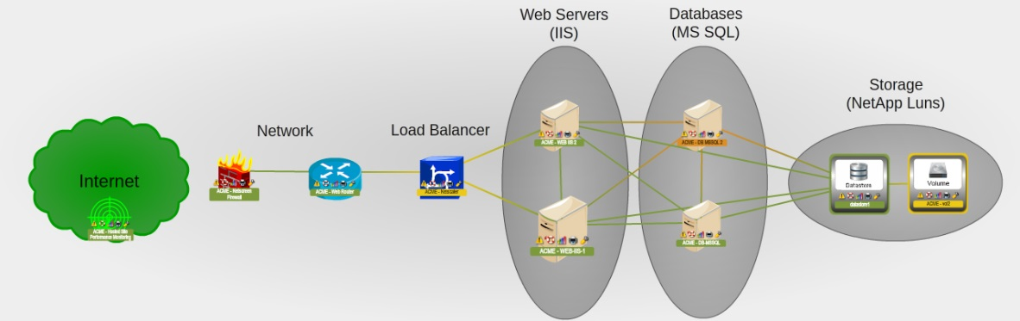
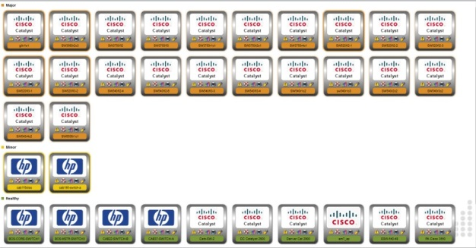
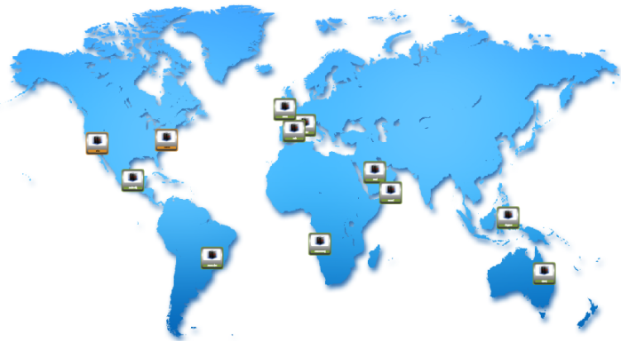
Viewing Devices

Slide 32
Objectives:
What are Views?
Buttons, Tools, Icons & Customization
Device Maps
Topology Maps
Creating/Deleting Customized Maps
Classic Views
Device Manager
Views

Slide 33
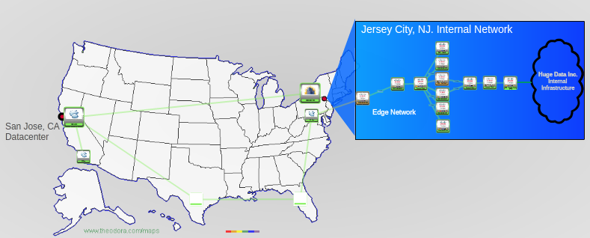
What are Views?
A View is a graphical representation of a group of devices and the relationships between them.
Views tab allows you to view, edit, and create maps
Device state color is reflected on the managed devices
Device Maps
Topology Maps
Custom Maps
Classic Views
Views
Notes:
In addition, in the ScienceLogic Views tab, you can view a NOC Screen. A NOC Screen is a custom graph of performance data collected by one or more Management Templates. A NOC Screen can be sized for display on a large monitor in a NOC.

Slide 34
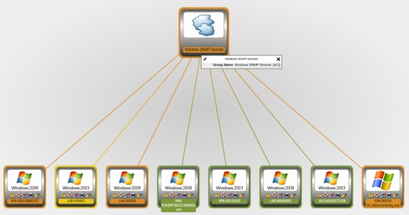
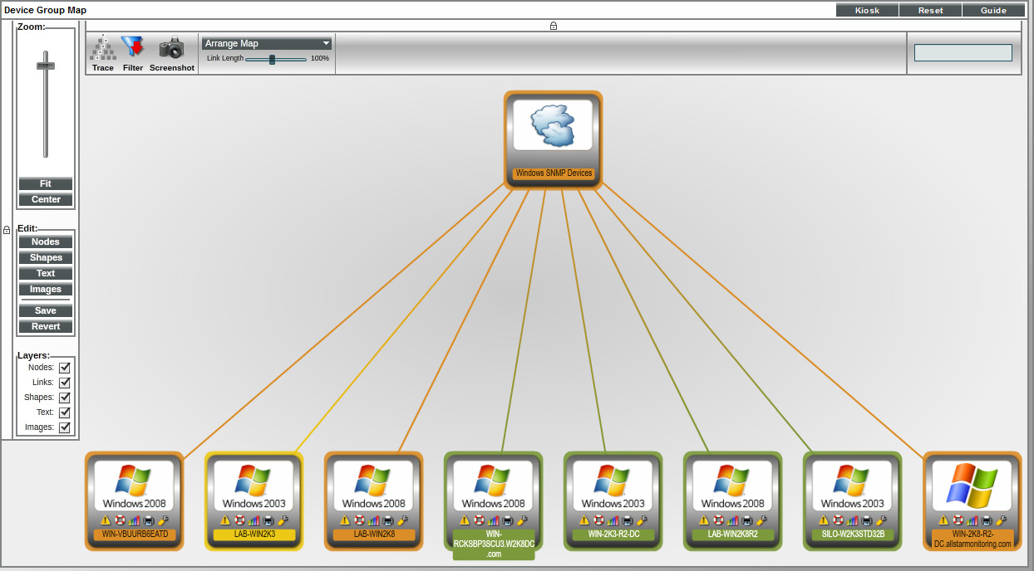
Buttons, Tools, Icons
Each map uses a similar set of buttons, tools, and icons.
Kiosk Button: Spawns a new page, where the map appears in full-screen
Lock Icon: Toggles on and off the display of the menu at the left of the pane and the menu at the top of the pane.
The icons are live, clickable links to the device information. Mouse over for quick info
Views
Notes:
Reset. Resets the default display. Any unsaved changes are removed.
Kiosk. Spawns a new page, where the map appears in full-screen. This display model is helpful in NOC environments.
Lock Icon. Toggles on and off the display of the menu at the left of the pane and the menu at the top of the pane. When the lock icon appears in white, the menu is "locked" and will continue to be displayed in the pane. When the lock icon appears in gray, the menu is displayed only when you are working in the menu. To make the hidden menu appear again, mouse over the border where the menu resides.
Select a Network drop-down field. Lists all IP networks discovered by ScienceLogic. Selecting an IP network displays its map. The blank field to the left of the network list allows you to "find while you type". You can enter a partial IP address, full IP address, partial network mask, or full network mask, and the list of networks in the network drop-down will be filtered to match the partial or full IP address or network mask.

Slide 35
Buttons, Tools, Icons
Zoom bar: Magnifies and contracts the map.
Fit: Adjusts the zoom to fit the entire map within the pane.
Center: Centers the map in the middle of the pane.
Trace + fields: Allows you to search and highlight multiple devices.
Filter icon: Toggles on and off the display of the Node Filters checkboxes.
Arrange Map: Specifies the format-style for the map.
Link Length slider: Slider bar that allows you to adjust the length of all links in the view.
Take Screenshot: Saves the current display as a .png file
Views
Notes:
Reset. Resets the default display. Any unsaved changes are removed.
Kiosk. Spawns a new page, where the map appears in full-screen. This display model is helpful in NOC environments.
Lock Icon. Toggles on and off the display of the menu at the left of the pane and the menu at the top of the pane. When the lock icon appears in white, the menu is "locked" and will continue to be displayed in the pane. When the lock icon appears in gray, the menu is displayed only when you are working in the menu. To make the hidden menu appear again, mouse over the border where the menu resides.
Select a Network drop-down field. Lists all IP networks discovered by ScienceLogic. Selecting an IP network displays its map. The blank field to the left of the network list allows you to "find while you type". You can enter a partial IP address, full IP address, partial network mask, or full network mask, and the list of networks in the network drop-down will be filtered to match the partial or full IP address or network mask.

Slide 36
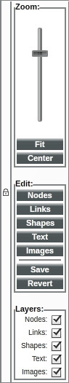
Buttons, Tools, Icons
Edit: Nodes. Edit the display of nodes in the map, only for custom maps.
Edit: Shapes. Allows you to add hand-drawn shapes to the map.
Edit: Text. Allows you to add text to the map and format that text.
Edit: Images. Allows you to import and format an image.
Edit: Save. Saves changes to the map.
Edit: Revert. Ignores all changes and returns to last saved version of the map.
Layers: Nodes. Toggles the display of devices in the map.
Layers: Links. Toggles the display of links in the map.
Layers: Shapes. Toggles the display of hand-drawn shapes in the map.
Layers: Text. Toggles the display of manually entered text in the map.
Layers: Images. Toggles the display of imported images in the map
Views
Notes:
Reset. Resets the default display. Any unsaved changes are removed.
Kiosk. Spawns a new page, where the map appears in full-screen. This display model is helpful in NOC environments.
Lock Icon. Toggles on and off the display of the menu at the left of the pane and the menu at the top of the pane. When the lock icon appears in white, the menu is "locked" and will continue to be displayed in the pane. When the lock icon appears in gray, the menu is displayed only when you are working in the menu. To make the hidden menu appear again, mouse over the border where the menu resides.
Select a Network drop-down field. Lists all IP networks discovered by ScienceLogic. Selecting an IP network displays its map. The blank field to the left of the network list allows you to "find while you type". You can enter a partial IP address, full IP address, partial network mask, or full network mask, and the list of networks in the network drop-down will be filtered to match the partial or full IP address or network mask.

Slide 37
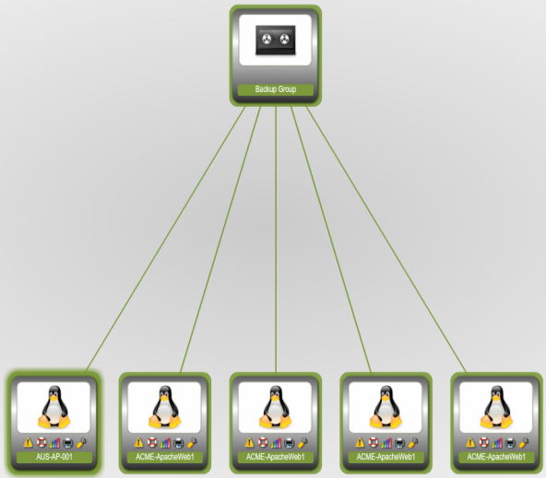
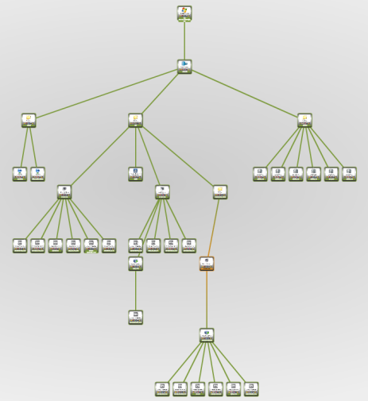
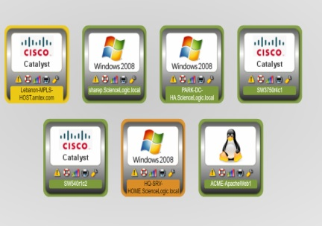
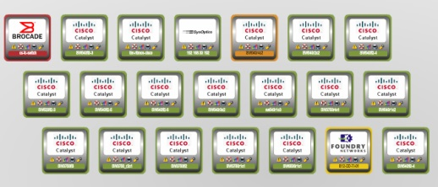
Maps: Device
Views > Device Maps
Device Group Map – EM7 will automatically create a Device Group Map for each user defined group of devices. Device Groups can be created while in Device Maps but not deleted.
Organization Map – Displays a map of the organization and its member devices.
Device Category Map – Allows you to view devices by device category, e.g. Routers, Switches, and Servers.
Component Map – Is a hierarchical view of a root node, the relationships between root nodes, parent components, and child components.
NOTE: You cannot add or delete devices from the device maps.
Views
Notes:
The Device Group Map page allows you to view devices by device group and also view the relationships between device groups and sub-groups. This makes it easy to visualize and manage device groups.
ScienceLogic automatically updates the Device Group View as new devices are added to device groups and as new device groups are defined. ScienceLogic also updates each view with the latest status and event information.
To view a device group, you must first select a device group from the drop-down list in the upper right.
Each device group and each member device appears as an icon.
Each view contains a parent device group, represented by an icon with a cloud image. All devices and sub-groups radiate from this device group.
Each member device is connected to its device group with a line. The color of the line specifies the device's current state. The state reflects the event of the highest severity for the device.
When the view appears, you can view and reposition the components. The view can be edited and re-arranged using drag-and-drop features. Devices and sub-groups can be repositioned for easier reading, if necessary.
Mousing over a device displays its name, IP address, device type, and device category.
Mousing over a device group displays its name.
To toggle between the view of the parent device-group and the view of a sub-group, you can select a view from the drop-down in the upper right.

Slide 38
Maps: Topology
During discovery, EM7 automatically discovers all networks and subnets in your infrastructure, and creates graphical representations of networks and subnets to create topology maps.
Views > Topology Maps > Layer-2
Layer-2 networks displays a network map, where you can view details of un-routed subnets, where devices are identified by MAC addresses.
Layer-2 links communicate over the Data Link Layer and use Ethernet and MAC addresses to communicate with devices in the same LAN or WAN
Views > Topology Maps > Layer-3
The Layer 3 Maps display a network map, where you can view details and relationships between Data Collectors and layer-3 routers and switches, and between the layer-3 routers and switches that have been discovered by EM7.
EM7 creates Layer-3 maps by running Traceroute from an EM7 Data Collection Unit to all devices that have layer-3 collection enabled in the device class.
Layer-3 networks are routed subnets, where devices are identified by IP address
Views

Slide 39
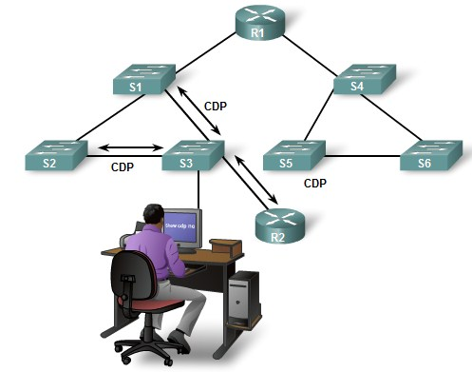
Maps: Topology
Views > Topology Maps > CDP
Cisco Discovery Protocol (CDP) displays a network map, where you can view details and relationships in any CDP network that has been discovered by EM7. This information includes:
MAC address and IP address
The operating system
Information about the network interface
CDP is a Layer-2 protocol that uses the Data Link Layer and is unrouted.
NOTE: Devices can not be added to these views using the nodes button.
Views

Slide 40
Maps: Customized
A customized map allows you to add the devices and links that are most important to you.
When you create a customized map, you are also creating a new device group which appears in the Device Groups page.
By default, device groups created in the My Customized Maps page include only Maps/Views under Visibility and have Shared set to no.
Customized maps appear in the following sections in the left NavBar:
Views > My Customized Maps. Personalized maps that you created
Views > User Customized Maps. If you are an EM7 user of type "administrator", you can navigate to the maps in this section to view and edit all customized maps in EM7.
Views > Shared Customized Maps. If a customized map or device group is defined as "shared", you can view the maps in this section.
Views

Slide 41
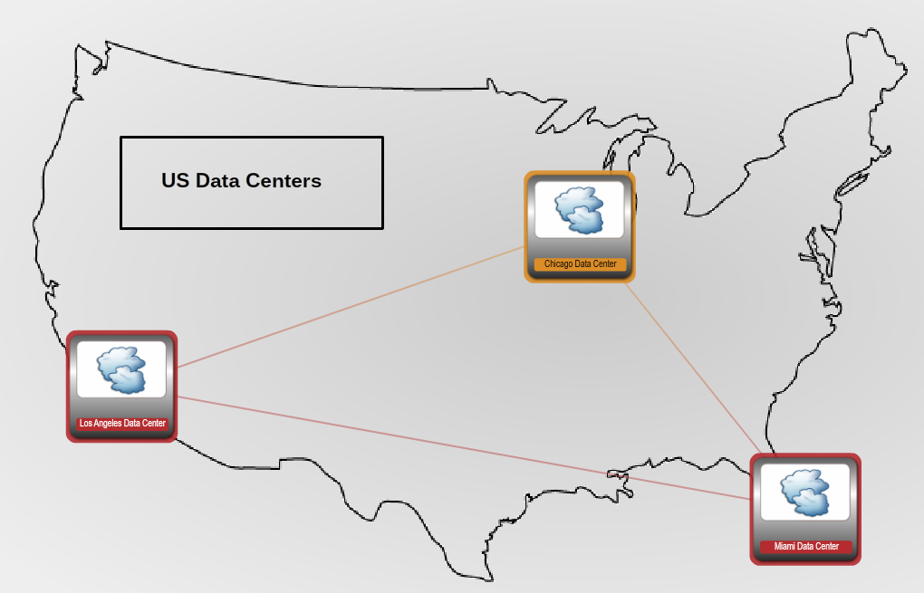
Custom Map Example
Clickable Device Groups on a geographical map
Views

Slide 42
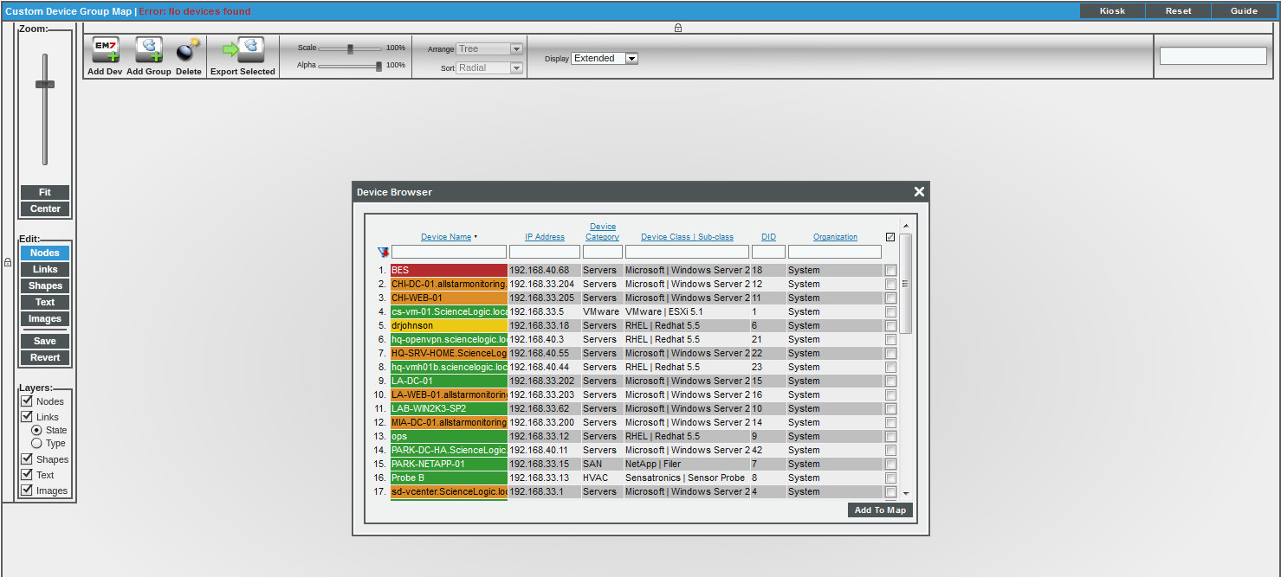
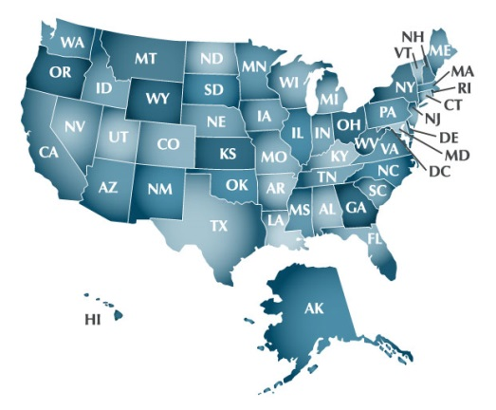
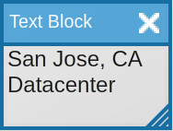
Customized Maps: Creating
Views > My Customized Maps > New Group/Map
Import a Background Image
Select Individual Nodes
Select other Groups
Create Links
Insert Text and Shapes
Save
Views
Notes:
To create a new customized map:
1. In the map pane, select the Edit:[Nodes] button to add devices and optionally device groups to your customized map.
2. To add a device to the Customized Map, in the Nodes menu at the top of the pane, select the Add Dev icon. When the Device Browser modal appears, search for the device(s) you want to add to the customized map. Select the checkbox for one or more devices you want to add to the customized map.
3. To add a device group to the Customized Map, in the Nodes menu at the top of the pane, select the Add Group icon. When the Device Browser modal page appears, search for the device group(s) you want to add to the customized map. Select the checkbox for one or more device groups you want to include in the customized map.
4. If ScienceLogic detects Layer-2, Layer-3, CDP, or VMware relationships between the devices, ScienceLogic automatically includes the appropriate links in the customized map.
5. After you add devices and device groups to the map, you can manually create links and edit existing links.
6. Clicking on an icon for a device group displays the customized map for that device group.
7. When you select the Edit:[Save] button, ScienceLogic prompts you to provide a name for the new customized map.
NOTE: You can also create a device group from the Device Groups page. If you select Maps in the Visibility field, the device group will appear as a map in Custom Device Group Map page (Views > My Customized Maps). If you set the Shared field to yes, the device group will appear as a map in Shared Customized Maps page (Views > Shared Customized Maps). By default, device groups created in the My Customized Maps page include only Maps/Views under Visibility and have Shared set to no. However, you can change these default settings by editing the device group from the Device Groups page.
When you delete a link in a Customized Map, the change is made only in that map. The link will still exist in ScienceLogic, and will appear in the other topology maps and will be used in event correlation.
When you edit a view-only relationship, the change is made only in that map. When you edit a CDP, Layer-2, Layer-3, or Event Correlation relationship, the changes are applied throughout ScienceLogic.

Slide 43

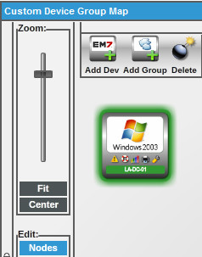
Customized Maps: Deleting
To delete an entry from a Customized Map, select the entry, select the button to make the menu appear at the top of the pane, and then select the Delete icon ( ).
To delete the Group completely from the My Customized Maps list you must go to Registry > Device Groups, find the device group, select the checkbox, and use Select Actions: DELETE Device Groups
Views

Slide 44
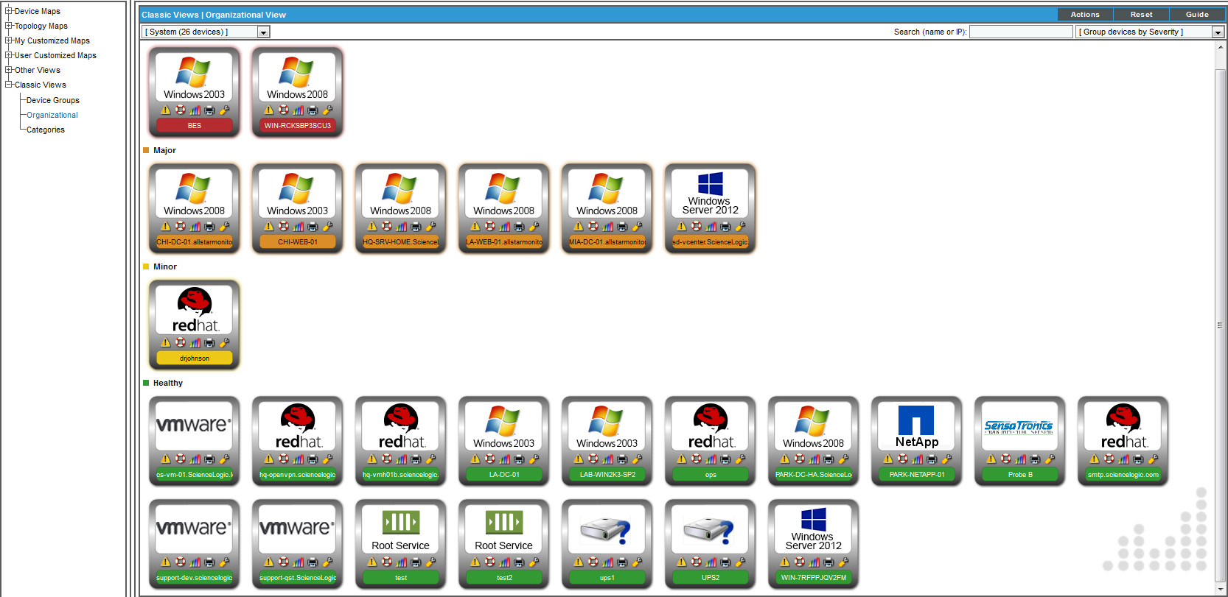
Views: Classic
Views > Classic Views
Drop down for displaying icons based on view
Views based on severity, name, class/make, sub-class/model, and category
Show/hide device icons
Detailed mouse over includes: Last poll time, collection status and device ID
EM7 automatically updates views as devices are added
Views

Slide 45
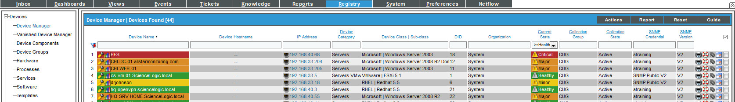
Device Manager View
Registry > Device Manager
As devices are discovered they will appear in the Device Manager. Device Manager gives a comprehensive table view of all devices and includes information such as:
Device Name | DID | Collection State
IP Address | Organization | SNMP Version
Device Category | Current State | SNMP Credential
Device Class | Sub-class | Collection Group
Views
Notes:
The Device Group Map page allows you to view devices by device group and also view the relationships between device groups and sub-groups. This makes it easy to visualize and manage device groups.
ScienceLogic automatically updates the Device Group View as new devices are added to device groups and as new device groups are defined. ScienceLogic also updates each view with the latest status and event information.
To view a device group, you must first select a device group from the drop-down list in the upper right.
Each device group and each member device appears as an icon.
Each view contains a parent device group, represented by an icon with a cloud image. All devices and sub-groups radiate from this device group.
Each member device is connected to its device group with a line. The color of the line specifies the device's current state. The state reflects the event of the highest severity for the device.
When the view appears, you can view and reposition the components. The view can be edited and re-arranged using drag-and-drop features. Devices and sub-groups can be repositioned for easier reading, if necessary.
Mousing over a device displays its name, IP address, device type, and device category.
Mousing over a device group displays its name.
To toggle between the view of the parent device-group and the view of a sub-group, you can select a view from the drop-down in the upper right.

Slide 46

Pro Tip
Nest device Groups to create a drill down effect for customized maps.
One of the uses for Custom Maps is for display in the Topology Dashboard Widget. Choose “Custom” in order to see the custom created views.
Views

Slide 47

Objectives:
What are Views?
Buttons, Tools, Icons & Customization
Device Maps
Topology Maps
Creating/Deleting Customized Maps
Classic Views
Device Manager
Views

Slide 48
What are Views?
A View is a graphical representation of a group of devices and the relationships between them.
Views tab allows you to view, edit, and create maps
Device state color is reflected on the managed devices
Device Maps
Topology Maps
Custom Maps
Classic Views
Views
Notes:
In addition, in the ScienceLogic Views tab, you can view a NOC Screen. A NOC Screen is a custom graph of performance data collected by one or more Management Templates. A NOC Screen can be sized for display on a large monitor in a NOC.

Slide 49
Buttons, Tools, Icons
Each map uses a similar set of buttons, tools, and icons.
Kiosk Button: Spawns a new page, where the map appears in full-screen
Lock Icon: Toggles on and off the display of the menu at the left of the pane and the menu at the top of the pane.
The icons are live, clickable links to the device information. Mouse over for quick info
Views
Notes:
Reset. Resets the default display. Any unsaved changes are removed.
Kiosk. Spawns a new page, where the map appears in full-screen. This display model is helpful in NOC environments.
Lock Icon. Toggles on and off the display of the menu at the left of the pane and the menu at the top of the pane. When the lock icon appears in white, the menu is "locked" and will continue to be displayed in the pane. When the lock icon appears in gray, the menu is displayed only when you are working in the menu. To make the hidden menu appear again, mouse over the border where the menu resides.
Select a Network drop-down field. Lists all IP networks discovered by ScienceLogic. Selecting an IP network displays its map. The blank field to the left of the network list allows you to "find while you type". You can enter a partial IP address, full IP address, partial network mask, or full network mask, and the list of networks in the network drop-down will be filtered to match the partial or full IP address or network mask.

Slide 50
Buttons, Tools, Icons
Zoom bar: Magnifies and contracts the map.
Fit: Adjusts the zoom to fit the entire map within the pane.
Center: Centers the map in the middle of the pane.
Trace + fields: Allows you to search and highlight multiple devices.
Filter icon: Toggles on and off the display of the Node Filters checkboxes.
Arrange Map: Specifies the format-style for the map.
Link Length slider: Slider bar that allows you to adjust the length of all links in the view.
Take Screenshot: Saves the current display as a .png file
Views
Notes:
Reset. Resets the default display. Any unsaved changes are removed.
Kiosk. Spawns a new page, where the map appears in full-screen. This display model is helpful in NOC environments.
Lock Icon. Toggles on and off the display of the menu at the left of the pane and the menu at the top of the pane. When the lock icon appears in white, the menu is "locked" and will continue to be displayed in the pane. When the lock icon appears in gray, the menu is displayed only when you are working in the menu. To make the hidden menu appear again, mouse over the border where the menu resides.
Select a Network drop-down field. Lists all IP networks discovered by ScienceLogic. Selecting an IP network displays its map. The blank field to the left of the network list allows you to "find while you type". You can enter a partial IP address, full IP address, partial network mask, or full network mask, and the list of networks in the network drop-down will be filtered to match the partial or full IP address or network mask.

Slide 51
Buttons, Tools, Icons
Edit: Nodes. Edit the display of nodes in the map, only for custom maps.
Edit: Shapes. Allows you to add hand-drawn shapes to the map.
Edit: Text. Allows you to add text to the map and format that text.
Edit: Images. Allows you to import and format an image.
Edit: Save. Saves changes to the map.
Edit: Revert. Ignores all changes and returns to last saved version of the map.
Layers: Nodes. Toggles the display of devices in the map.
Layers: Links. Toggles the display of links in the map.
Layers: Shapes. Toggles the display of hand-drawn shapes in the map.
Layers: Text. Toggles the display of manually entered text in the map.
Layers: Images. Toggles the display of imported images in the map
Views
Notes:
Reset. Resets the default display. Any unsaved changes are removed.
Kiosk. Spawns a new page, where the map appears in full-screen. This display model is helpful in NOC environments.
Lock Icon. Toggles on and off the display of the menu at the left of the pane and the menu at the top of the pane. When the lock icon appears in white, the menu is "locked" and will continue to be displayed in the pane. When the lock icon appears in gray, the menu is displayed only when you are working in the menu. To make the hidden menu appear again, mouse over the border where the menu resides.
Select a Network drop-down field. Lists all IP networks discovered by ScienceLogic. Selecting an IP network displays its map. The blank field to the left of the network list allows you to "find while you type". You can enter a partial IP address, full IP address, partial network mask, or full network mask, and the list of networks in the network drop-down will be filtered to match the partial or full IP address or network mask.

Slide 52
Maps: Device
Views > Device Maps
Device Group Map – EM7 will automatically create a Device Group Map for each user defined group of devices. Device Groups can be created while in Device Maps but not deleted.
Organization Map – Displays a map of the organization and its member devices.
Device Category Map – Allows you to view devices by device category, e.g. Routers, Switches, and Servers.
Component Map – Is a hierarchical view of a root node, the relationships between root nodes, parent components, and child components.
NOTE: You cannot add or delete devices from the device maps.
Views
Notes:
The Device Group Map page allows you to view devices by device group and also view the relationships between device groups and sub-groups. This makes it easy to visualize and manage device groups.
ScienceLogic automatically updates the Device Group View as new devices are added to device groups and as new device groups are defined. ScienceLogic also updates each view with the latest status and event information.
To view a device group, you must first select a device group from the drop-down list in the upper right.
Each device group and each member device appears as an icon.
Each view contains a parent device group, represented by an icon with a cloud image. All devices and sub-groups radiate from this device group.
Each member device is connected to its device group with a line. The color of the line specifies the device's current state. The state reflects the event of the highest severity for the device.
When the view appears, you can view and reposition the components. The view can be edited and re-arranged using drag-and-drop features. Devices and sub-groups can be repositioned for easier reading, if necessary.
Mousing over a device displays its name, IP address, device type, and device category.
Mousing over a device group displays its name.
To toggle between the view of the parent device-group and the view of a sub-group, you can select a view from the drop-down in the upper right.

Slide 53
Maps: Topology
During discovery, EM7 automatically discovers all networks and subnets in your infrastructure, and creates graphical representations of networks and subnets to create topology maps.
Views > Topology Maps > Layer-2
Layer-2 networks displays a network map, where you can view details of un-routed subnets, where devices are identified by MAC addresses.
Layer-2 links communicate over the Data Link Layer and use Ethernet and MAC addresses to communicate with devices in the same LAN or WAN
Views > Topology Maps > Layer-3
The Layer 3 Maps display a network map, where you can view details and relationships between Data Collectors and layer-3 routers and switches, and between the layer-3 routers and switches that have been discovered by EM7.
EM7 creates Layer-3 maps by running Traceroute from an EM7 Data Collection Unit to all devices that have layer-3 collection enabled in the device class.
Layer-3 networks are routed subnets, where devices are identified by IP address
Views

Slide 54
Maps: Topology
Views > Topology Maps > CDP
Cisco Discovery Protocol (CDP) displays a network map, where you can view details and relationships in any CDP network that has been discovered by EM7. This information includes:
MAC address and IP address
The operating system
Information about the network interface
CDP is a Layer-2 protocol that uses the Data Link Layer and is unrouted.
NOTE: Devices can not be added to these views using the nodes button.
Views

Slide 55
Maps: Customized
A customized map allows you to add the devices and links that are most important to you.
When you create a customized map, you are also creating a new device group which appears in the Device Groups page.
By default, device groups created in the My Customized Maps page include only Maps/Views under Visibility and have Shared set to no.
Customized maps appear in the following sections in the left NavBar:
Views > My Customized Maps. Personalized maps that you created
Views > User Customized Maps. If you are an EM7 user of type "administrator", you can navigate to the maps in this section to view and edit all customized maps in EM7.
Views > Shared Customized Maps. If a customized map or device group is defined as "shared", you can view the maps in this section.
Views

Slide 56
Customized Maps: Creating
Views > My Customized Maps > New Group/Map
Import a Background Image
Select Individual Nodes
Select other Groups
Create Links
Insert Text and Shapes
Save
Views
Notes:
To create a new customized map:
1. In the map pane, select the Edit:[Nodes] button to add devices and optionally device groups to your customized map.
2. To add a device to the Customized Map, in the Nodes menu at the top of the pane, select the Add Dev icon. When the Device Browser modal appears, search for the device(s) you want to add to the customized map. Select the checkbox for one or more devices you want to add to the customized map.
3. To add a device group to the Customized Map, in the Nodes menu at the top of the pane, select the Add Group icon. When the Device Browser modal page appears, search for the device group(s) you want to add to the customized map. Select the checkbox for one or more device groups you want to include in the customized map.
4. If ScienceLogic detects Layer-2, Layer-3, CDP, or VMware relationships between the devices, ScienceLogic automatically includes the appropriate links in the customized map.
5. After you add devices and device groups to the map, you can manually create links and edit existing links.
6. Clicking on an icon for a device group displays the customized map for that device group.
7. When you select the Edit:[Save] button, ScienceLogic prompts you to provide a name for the new customized map.
NOTE: You can also create a device group from the Device Groups page. If you select Maps in the Visibility field, the device group will appear as a map in Custom Device Group Map page (Views > My Customized Maps). If you set the Shared field to yes, the device group will appear as a map in Shared Customized Maps page (Views > Shared Customized Maps). By default, device groups created in the My Customized Maps page include only Maps/Views under Visibility and have Shared set to no. However, you can change these default settings by editing the device group from the Device Groups page.
When you delete a link in a Customized Map, the change is made only in that map. The link will still exist in ScienceLogic, and will appear in the other topology maps and will be used in event correlation.
When you edit a view-only relationship, the change is made only in that map. When you edit a CDP, Layer-2, Layer-3, or Event Correlation relationship, the changes are applied throughout ScienceLogic.

Slide 57
Custom Map Example
Clickable Device Groups on a geographical map
Views

Slide 58
Customized Maps: Deleting
To delete an entry from a Customized Map, select the entry, select the button to make the menu appear at the top of the pane, and then select the Delete icon ( ).
To delete the Group completely from the My Customized Maps list you must go to Registry > Device Groups, find the device group, select the checkbox, and use Select Actions: DELETE Device Groups
Views

Slide 59
Views: Classic
Views > Classic Views
Drop down for displaying icons based on view
Views based on severity, name, class/make, sub-class/model, and category
Show/hide device icons
Detailed mouse over includes: Last poll time, collection status and device ID
EM7 automatically updates views as devices are added
Views

Slide 60
Device Manager View
Registry > Device Manager
As devices are discovered they will appear in the Device Manager. Device Manager gives a comprehensive table view of all devices and includes information such as:
Device Name | DID | Collection State
IP Address | Organization | SNMP Version
Device Category | Current State | SNMP Credential
Device Class | Sub-class | Collection Group
Views
Notes:
The Device Group Map page allows you to view devices by device group and also view the relationships between device groups and sub-groups. This makes it easy to visualize and manage device groups.
ScienceLogic automatically updates the Device Group View as new devices are added to device groups and as new device groups are defined. ScienceLogic also updates each view with the latest status and event information.
To view a device group, you must first select a device group from the drop-down list in the upper right.
Each device group and each member device appears as an icon.
Each view contains a parent device group, represented by an icon with a cloud image. All devices and sub-groups radiate from this device group.
Each member device is connected to its device group with a line. The color of the line specifies the device's current state. The state reflects the event of the highest severity for the device.
When the view appears, you can view and reposition the components. The view can be edited and re-arranged using drag-and-drop features. Devices and sub-groups can be repositioned for easier reading, if necessary.
Mousing over a device displays its name, IP address, device type, and device category.
Mousing over a device group displays its name.
To toggle between the view of the parent device-group and the view of a sub-group, you can select a view from the drop-down in the upper right.

Slide 61
Pro Tip
Nest device Groups to create a drill down effect for customized maps.
One of the uses for Custom Maps is for display in the Topology Dashboard Widget. Choose “Custom” in order to see the custom created views.
Views

Slide 62
Resources And Questions
For more information:
Views
Guide Button within EM7
All manuals are available on the Customer Portal:
http://portal.sciencelogic.com
Views

Slide 63
Views Lab Goals
Create multiple “drill down” maps to logically lay out global and US data centers
Learn the bottom up build technique
Learn the editing tools and methods
Images upload and selection
Device and Device Group selection
Shape editing
Text inclusion
Views

Slide 64
Lab: Views
Create a Custom Map for Miami Data Center
Go to Views > My Customized Maps > New Group/Map
Click the [Save] button, name the map “Miami Data Center” and click [OK]
Verify that you are in Views > My Customized Maps > Miami Data Center
Click [Nodes] button
Click [Add Dev] button
Choose “MIA-DC-01.allstarmonitoring.com” and “MIA-WEB-01” and click [Add To Map]
Arrange devices on the map (use the [Center] button to help)
Select different values from the Display drop down to observe the affect on the devices
Select [Save]
Views

Slide 65
Lab: Views
Create a Custom Map for Chicago Data Center
Go to Views > My Customized Maps > New Group/Map
Click the [Save] button, name the map “Chicago Data Center” and click [OK]
Verify that you are in Views > My Customized Maps > Chicago Data Center
Click [Nodes] button
Click [Add Dev] button
Choose “CHI-DC-01.allstarmonitoring.com” and “CHI-WEB-01” and click [Add To Map]
Arrange devices on the map (use the [Center] button to help)
Select different values from the Display drop down to observe the effect on the devices
Select [Save]
Views

Slide 66
Lab: Views
Create a Custom Map for Los Angeles Data Center
Go to Views > My Customized Maps > New Group/Map
Click the [Save] button, name the map “Los Angeles Data Center” and click [OK]
Verify that you are in Views > My Customized Maps > Los Angeles Data Center
Click [Nodes] button
Click [Add Dev] button
Choose “LA-DC-01.allstarmonitoring.com” and “LA-WEB-01” and click [Add To Map]
Arrange devices on the map (use the [Center] button to help)
Select different values from the Display drop down to observe the affect on the devices
Select [Save]
Views

Slide 67
Lab: Views
Create a Custom Map and add USA background image
Go to Views > My Customized Maps > New Group/Map
Click the [Save] button, name the map “US Data Centers” and click [OK]
Verify that you are in Views > My Customized Maps > US Data Centers
In a separate browser tab go to: http://www.worldatlas.com/webimage/countrys/namerica/usstates/usashape.htm
Right click the image and Save Image As… on your desktop (it should save as “usashape.gif”
Back in EM7, click [Images] button, then [Add] green plus sign
Click the [Browse] button, select the “usashape.gif” file and click [Upload]
Once the image appears in the window double click the USA Outline Map image
Click and drag on the corner of the image to stretch it out to cover most of the page
Click [Nodes] button
Click [Add Group] button
Choose the Miami, Chicago, and Los Angeles Data Centers and [Add To Map]
Arrange device groups on the map to represent their geographic locations
Continued on next slide…
Views

Slide 68
Lab: Views (cont.)
Add links, shapes, and text:
Click the [Links] button
Single click one of the Device Groups nodes and then single click one of the other Device Groups nodes.
In the Link editor choose the relationship of the two devices. The relationship choices are Parent > Child, Child > Parent, and Sibling > Sibling. For this lab exercise choose Sibling > Sibling. Click the “X” to close the relationship dialog
Repeat previous step in order to draw in links between the devices
Click the [Shapes] button
Choose Rectangle from shapes editor
Draw a box in the open space in the pacific northwest
Click the [Text] button and click green [Add] plus sign
Enter text “US Data Centers”, highlight it and increase the font size from the editor controls.
Put text box in the previously drawn rectangle
Select [Save]
Views

Slide 69
Lab: Views
Create a Custom Map and add World Map background image
Go to Views > My Customized Maps > New Group/Map
Click the [Save] button, name the map “Global Data Centers” and click [OK]
Verify that you are in Views > My Customized Maps > Global Data Centers
In a separate browser tab go to: http://mapnall.com/en/map/Map-World_41229.html
Right click the image and Save Image As… on your desktop (it should save as “World-Outline-Map.jpg”
Back in EM7, click [Images] button, then [Add] green plus sign
Click the [Browse] button, select the World-Outline-Map.jpg file
Click [Upload]
Double click the World Outline Map image
Click [Nodes] button, Click [Add Group] button
Choose US Data Centers and click [Add To Map]
Arrange devices on the map in the US area of the world
Select [Save]
Views

Slide 70
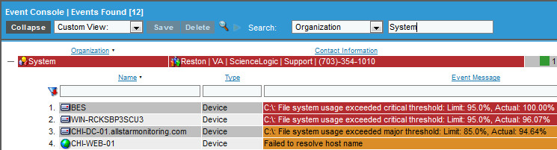
Event Console

Slide 71
Objectives
What is an Event?
The Event Console
Viewing Events
Global Search and Saving Views
Responding to Events
Event Console preferences
Event Console

Slide 72

What is an Event?
Events are messages that are triggered when (metrics or messages meet) a specific condition is met, such as a threshold
EM7 has events defined for the commonly encountered conditions on the most common platforms
EM7 will create events based on Syslog and SNMP Trap messages that match an Event Definition
5 severity levels (Critical, Major, Minor, Notice, and Healthy)
Event Console
Notes:
An event can signal a server has gone down, that a device is exceeding CPU or disk-space thresholds, that communication with a device has failed, or it can simply display the status of a managed element.
ScienceLogic examines each log message and compares it to each event definition. If a log message matches an event's definition, ScienceLogic generates an event instance and displays the event in the Event Console page.
You might want to create custom events for your specific environment or edit the pre-defined events to better fit your specific environment.

Slide 73
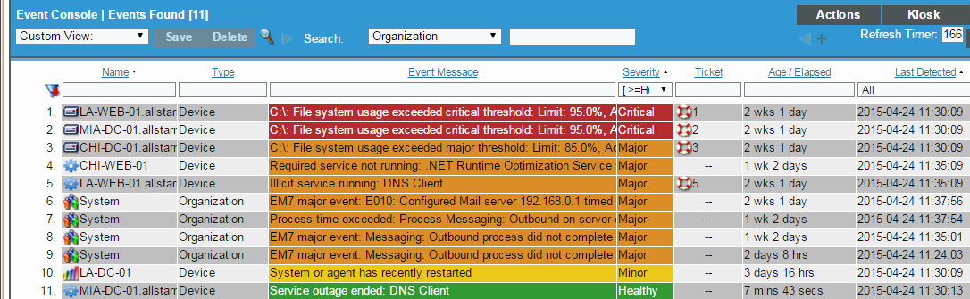
Event Sources
ScienceLogic event sources are determined by the inbound message or collection process type:
Syslog: Message is generated by the managed device and sent to ScienceLogic via the Syslog protocol.
Trap: Message is generated by the managed device and sent to ScienceLogic via the SNMP Trap protocol.
Email: Message was emailed to ScienceLogic from a third-party agent.
API: Message came from a managed device or integrated external system via the API.
Dynamic: Message generated by an ScienceLogic Dynamic Application.
Internal: Message is generated by an ScienceLogic process such as File System monitoring or availability checking.
ScienceLogic
Syslog
Message
Trap
Message
Email Message
API Message
Dynamic App Message
Internal Message
Event Console
Notes:
Syslog. Windows log files can be converted to syslog format using conversion tools. Devices monitored by ScienceLogic forward syslog messages to ScienceLogic. ScienceLogic includes pre-defined events for common problems that are logged in syslog. ScienceLogic examines each incoming log message and determines if the log message matches an event definition. If it does, ScienceLogic generates an instance of that event.
Internal. ScienceLogic includes predefined events for common problems that are logged in the ScienceLogic logs. ScienceLogic examines each log message and determines if the log message matches an event definition. If it does, ScienceLogic generates an instance of that event.
Trap. SNMP traps can be sent by devices and proxy devices like MoMs (mangers of mangers). An SNMP trap is an unsolicited message from a device to ScienceLogic. A trap indicates that an emergency condition or a condition that merits immediate attention has occurred on the device. Devices monitored by ScienceLogic can be configured to forward traps to ScienceLogic. ScienceLogic examines each incoming trap message and determines if the message matches an event definition. If it does, ScienceLogic generates an instance of that event.
Dynamic. This tool allows ScienceLogic to monitor applications and devices that use SNMP or other agents. Users can define alerts to trigger ScienceLogic events. Alerts allow users to trigger events based upon values retrieved by Management Templates. Alerts allow users to examine and manipulate values retrieved by Management Templates. When an alert evaluates to TRUE, the alert inserts a message in each associated device’s device log. ScienceLogic examines each new message in the device log and determines if the message matches an event definition. If it does, ScienceLogic generates an instance of that event.
E-Mail. ScienceLogic examines each new message and determines if the message matches an event definition. If it does, ScienceLogic generates an instance of that event.

Slide 74
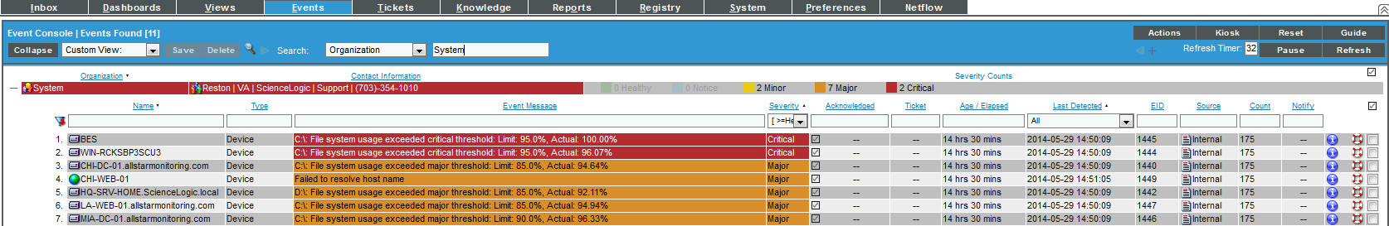
Events Console
View all active events
When information collected by EM7 meet the criteria specified in an Event Definition, an active event is created and displayed on the Events Console.
Name | Note | EID
Type | Ticket | Source
Event Message | External Ticket | Count
Severity | Age / Elapsed | Notify
Acknowledged | Last Detected
Event Console
Notes:
The Event Console page displays a list of all currently active events (that you are allowed to view). From this page, you can view, acknowledge, clear, suppress, or disable an event. You can also create a ticket based upon an event.
You can also use the Device Administration panel and the Device Reports panel to view a list of events for a single device. The events are displayed in a page that is similar to the Event Console page, but displays only events that occurred on the selected device.

Slide 75
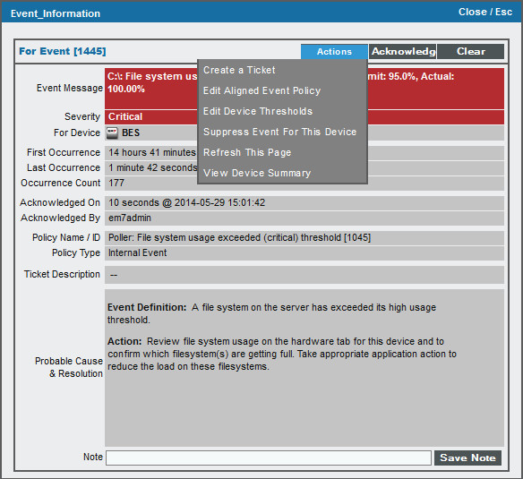

Event Console: Event Details
Suppress Event means that the event will not come in for this device any longer
First and last occurrence of event
Who Acknowledged & When
Add notes to the Event and they show up on the console in the Notes column
This text from the Event Definition
Event Console
Notes:
To access the Event Information page:
1. Go to the Events tab or the Viewing Active Events page for a device.
2. Find the event you are interested in.
3. Select its information icon.
4. The Event Information page appears.
5. The Event Information page displays the following details about the event:
Event ID. Unique ID for the event, generated by ScienceLogic.
Event Message. Message generated by event, as defined in the Event Policy Editor page (Registry > Events > Event Manager).
Severity. Severity of the event.
For Element. Name of the element associated with the event.
First Occurrence. Number of days and hours since the first occurrence of the event. Date and time of first occurrence of the event.
Last Occurrence. Number of days and hours since the last occurrence of the event. Date and time of last occurrence of the event.
Occurrence Count. Number of times this event has occurred on this entity.
Acknowledged On. Date and time the event was acknowledged.
Acknowledged By. User name of user who acknowledged the event.
Policy Name. Name of the event policy, as defined in the Event Policy Editor page (Registry > Events > Event Manager).
Policy Type. Source of the log message that triggers the event, as defined in the Event Policy Editor page (Registry > Events > Event Manager).
Ticket Description. Description field from the associated ticket, if applicable.
Probable Cause & Resolution Text. This pane displays additional information about the event, as defined in the Event Policy Editor page (Registry > Events > Event Manager).
6. Depending on your Access Keys, the [Actions] menu displays one or more of the following entries:
Create a Ticket. Leads to the Create New Ticket page , where you can define a new ticket based on the event.
Edit Aligned Event Policy. Leads to the Event Policy Editor page (Registry > Events > Event Manager), where you can edit the properties of the event definition.
Edit Device Thresholds. Leads to the Device Thresholds page , where you can define and edit space and performance thresholds for a device.
Suppress Event for This Device. Suppresses the current event on the current device. When you suppress an event, you are specifying that in the future, if this event occurs again on the same device, the event will not appear in the Event Console or the Viewing Events page.
Refresh This Page. Updates the page with the latest information.
View Device Summary. Leads to the Device Summary page for the device, where you can view overview information on the health of the device, a list of events and tickets associated with the device, a list of ScienceLogic elements associated with the device, a list of monitoring policies for the device, and hardware and bandwidth usage for the device.

Slide 76

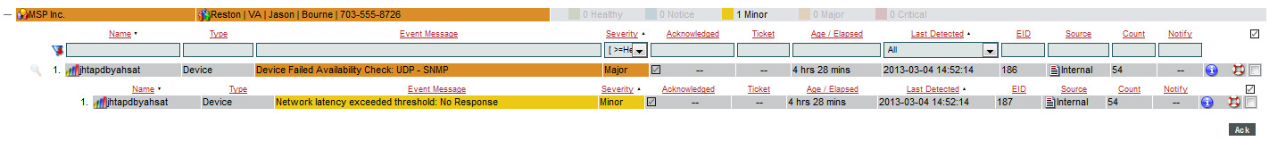
Event Console: Roll-up
Events Tab
Clicking the “magnifying Glass Icon” will show events with equal or lower event status on the same device.
Events suppression is based on the time window they’ve come in. By default they are grouped in a rolling 10 minute window called the “Event Mask”.
Event Console
Notes:
When you clear an event, you remove only a single instance of the event from the current display in the Event Console page. If the event occurs again on the same entity, it will reappear in the Event Console page.
To clear an event:
1. Go to the Events tab.
2. In the Event Console page, find the event you want to clear. Click on the checkbox for that event.
3. For each event that you want to clear, select its checkbox. To select all events in an organization, click on the check-mark icon to the right and above each organization's group of event.
4. Notice the small [Del] button under each organization's group of event. Select this button to clear the selected events.
5. When you successfully clear an event, it will no longer appear in the display in the Event Console page.

Slide 77
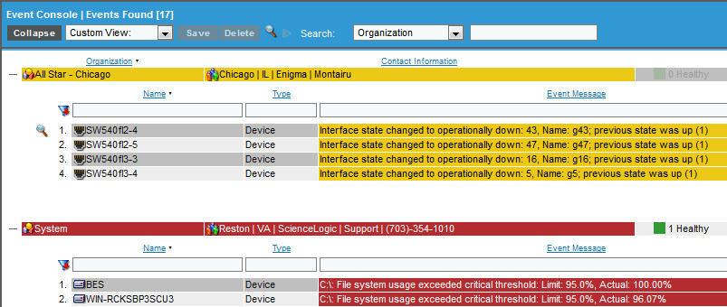
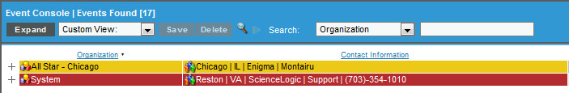
Event Console: Collapse
Events Tab
Clicking “Collapse” will collapse the event screen down to a single row for each Organization.
Event Console
Notes:
When you clear an event, you remove only a single instance of the event from the current display in the Event Console page. If the event occurs again on the same entity, it will reappear in the Event Console page.
To clear an event:
1. Go to the Events tab.
2. In the Event Console page, find the event you want to clear. Click on the checkbox for that event.
3. For each event that you want to clear, select its checkbox. To select all events in an organization, click on the check-mark icon to the right and above each organization's group of event.
4. Notice the small [Del] button under each organization's group of event. Select this button to clear the selected events.
5. When you successfully clear an event, it will no longer appear in the display in the Event Console page.

Slide 78
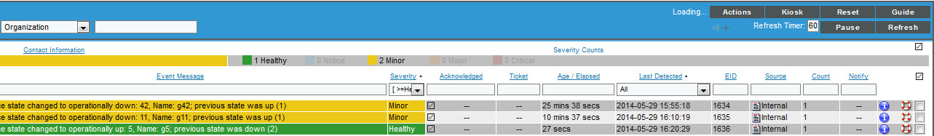
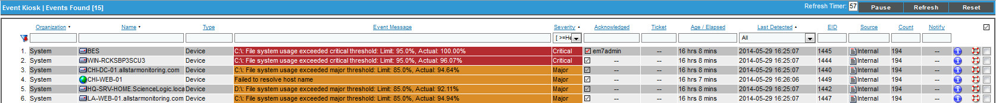
Event Console: Kiosk
Events > Kiosk
Clicking [Kiosk] spawns new window with no top banner or tabs.
Event Console
Notes:
When you clear an event, you remove only a single instance of the event from the current display in the Event Console page. If the event occurs again on the same entity, it will reappear in the Event Console page.
To clear an event:
1. Go to the Events tab.
2. In the Event Console page, find the event you want to clear. Click on the checkbox for that event.
3. For each event that you want to clear, select its checkbox. To select all events in an organization, click on the check-mark icon to the right and above each organization's group of event.
4. Notice the small [Del] button under each organization's group of event. Select this button to clear the selected events.
5. When you successfully clear an event, it will no longer appear in the display in the Event Console page.

Slide 79

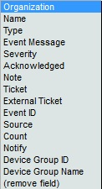
Event Console Global Search
Search using the Dropdowns
Clicking the plus sign adds another search box
Event Console
Notes:
The Search fields at the top of the Event Console allow you to search all events and display only those events that match the search criteria. You can also filter and sort the results of a search.
You can search by only one of the search fields, by multiple search fields, or by all of the search fields.
You can search by three fields:
Column name (one of the following: organization, device name, event message, ticket ID, event ID, entity type) or device group (name of device group or ID of device group)/
Event Age or Last Detected
Severity
You can filter the search results by:
All events that match the search criteria (filter on None)
Only Unacknowledged events
Only Acknowledged events
You can sort the search results by:
Severity
Date and time last Detected
Event Age
Entity Name
Event Message
Ticket ID
Event Count

Slide 80
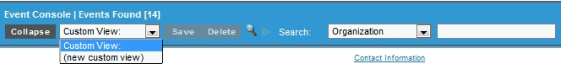
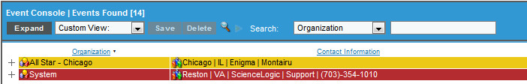
Event Console Custom View
Save Filters
Event Console Tab
Custom views can be made by:
Selecting search criteria
Selecting New Custom View
Hit [Save] button
Enter name for the saved search
Hit [OK]
Saved Views are per user
Collapse all organizations, plus sign shows each orgs events
Event Console
Notes:
Collapse. Collapses the display in the Event Console page so only Organization names appear. Events are hidden under the heading for their assigned organization.
Layout. If a user expands and/or contracts events under one or more Organizations and then selects the [Layout] button, ScienceLogic will remember which organizations were expanded and which were contracted. When the user returns to the Event Console page, the same organizations will be expanded and contracted.
Kiosk. Spawns a new browser window, in which the Event Console page appears in full screen By default, the kiosk page has focus, but users can minimize the kiosk to return focus to ScienceLogic. By default, in Kiosk view, events are grouped by severity, not Organization; critical events are listed first. The results of searches, filters, and sorts are maintained in Kiosk view.
Full. Spawns a new browser window, in which the Event Console page appears in full screen By default, the full page has focus, but users can minimize the kiosk to return focus to ScienceLogic. By default, in Full view, events are grouped by Organization and then severity. The results of searches, filters, and sorts are maintained in Full view.
Pause. Pauses the refresh timer.
Refresh. Manually refreshes the display. Updates the list of events with any changes to existing events and with any new events.

Slide 81
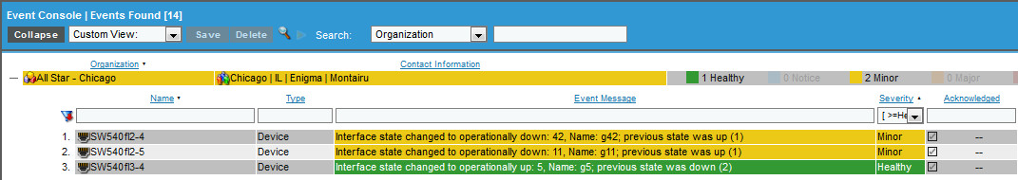

Respond to Events: Acknowledge
Events
Event Console
Notes:
ScienceLogic allows you to acknowledge new events as they are detected by the system. Acknowledging an event lets other users know that you are aware of the event and working on the event.
When an event has been acknowledged, a gray checkmark appears next to the event in the Event Console page and the acknowledging user’s name appears with the checkmark. This lets other ScienceLogic users know that someone is investigating or taking action on the event.
To acknowledge an event:
1. Go to the Events tab.
2. In the Event Console page, find the event you want to acknowledge. Click on the checkbox for the event.
3. For each event that you want to acknowledge, select its checkbox. To select all events in an organization, click on check-mark icon to the right and above each organization's group of events.
4. Notice the small [Ack] button under each organization's group of events. Select this button to acknowledge the selected events.
5. For each acknowledged event, your username will be added to the Acknowledged column.

Slide 82


Respond to Events: Clear
Events
Two methods to clear an event:
On screen button:
Select one or more events to clear
Click [Del] button
Select Actions Drop Down:
Select event to clear
Select Actions > Clear
[GO]
Event Console
Notes:
When you clear an event, you remove only a single instance of the event from the current display in the Event Console page. If the event occurs again on the same entity, it will reappear in the Event Console page.
To clear an event:
1. Go to the Events tab.
2. In the Event Console page, find the event you want to clear. Click on the checkbox for that event.
3. For each event that you want to clear, select its checkbox. To select all events in an organization, click on the check-mark icon to the right and above each organization's group of event.
4. Notice the small [Del] button under each organization's group of event. Select this button to clear the selected events.
5. When you successfully clear an event, it will no longer appear in the display in the Event Console page.

Slide 83

Viewing Cleared Events
Device Reports Panel > Events > Cleared
Cleared events are listed per device in the Device Reports Panel > Events tab
Cleared events are not listed on the Events Console
Event Console

Slide 84





Event Console Action Menu
Event Console
Notes:
Console Preferences. Leads to the Event Viewer Preferences modal page, where users can customize the display of the Event.
Event Statistics. Leads to the Event Statistics page, where users can view daily, weekly, and monthly trends of all events (on all entities).
Event Policy Manager. Leads to the Event Policy Manager page, where you can view a list of all event policies, view details of each event policy, define new event policies, and edit existing event policies.
RSS Feed Manager. Leads to the RSS News Feed Manager page, where you can view and edit existing RSS feed monitors and define new RSS news feed monitors.

Slide 85
Event Console Preferences
Events > Action dropdown
Add and remove Event Console columns for your user account
Change the default grouping behavior on the page
Event Console
Notes:
The Event Console Preferences page allows you to customize the display and behavior of the Event Console page.
To access the Event Console Preferences page:
1. Go to the Events tab.
2. In the Event Console page, select the [Actions] menu and choose Console Preferences.
3. The Event Console Preferences page appears.
4. In the Event Console Preferences page, you can customize the following:
Console Refresh Rate. Specifies how often the Event Console page in ScienceLogic will be refreshed. The possible choices are between 15 seconds and 1 hour.
Console Height. Specifies the vertical height of the Event Console page. A larger height allows more events to be displayed on a single page, but may require vertical scrolling. The choices are 400 pixels – 2400 pixels.
Default Severity Filter. When a severity is selected, the Event Console page will display only events of the selected severity and greater.
o Healthy. Will display all events, including events with a severity of Healthy.
o Notice. Will display all events with a severity of Notice, Major, Minor, and Critical.
o Minor. Will display all events with a severity of Minor, Major, and Critical.
o Major. Will display all events with a severity of Major and Critical.
o Critical. Will display all events with a severity of Critical.
Show Suppressed Events. If you select this checkbox, all event instances that have been grouped together under a single event description will be displayed in the Event Console page. The default behavior of ScienceLogic is to roll-up related events under a single description.
Collapse All Organizations. If you select this checkbox, all organizations with associated events will be displayed but will be contracted; the Event Console page will display only a list of contracted organizations, which can be expanded by clicking on the plus sign (+). The default behavior of ScienceLogic is to expand each organization and display the list of events for each organization.
Event Console Columns. In this list, you can select the default columns to be displayed in the Event Console page.
5. Select the[ Save] button to save your changes in the Event Console Preferences page.

Slide 86
Resources And Questions
For more information:
Events manual
Guide Button
All manuals are available on the Customer Portal:
http://portal.sciencelogic.com
Event Console

Slide 87
Lab: Events
Remove Column from Events Console
Click the [Actions] button
Select Console Preferences
Under Event Monitor Columns deselect “Note” (control+click)
Click [Save]
Save and View a Custom View
In the Search drop down choose Event Message and enter “File” in the adjacent test box
In the Custom View dropdown select (new custom view)
Click the [Save] button
Enter “File System Events” in the dialog box
Click the [OK] button
Click the [Events] button to re-set the Event Console
In the Custom View dropdown select File System Events
Event Console

Slide 88
Lab: Event Console
Acknowledge and then Clear an event
Click [Events]
Find a “C:\: File system usage exceeded major threshold” event
Click [Ack] and [OK]
Note that your user name is now reflected in the Ack column
Select the same event and note the device name
Click [Del]
Note that the event has been cleared from the Event Console
Go to Registry > Device Manager and search for the device
Go to Device Reports Panel > Events for the device
Click the [Cleared] button
Note that the recently cleared event is listed
Event Console

Slide 89

Ticket Console

Slide 90
Objectives
Benefits of EM7 Ticketing
What is a Ticket?
Ticket Console
Creating Tickets
Viewing Tickets
Resolving Tickets
Ticket Watchers
Ticket Queues
Ticketing Console

Slide 91

Benefits of Ticketing in EM7
Integrate event and ticketing for seamless operations
Automate notifications, escalations, and response/remediation
Align processes to customized workflows
Ticketing Console

Slide 92

What is a Ticket?
A ticket is a request for work and a log of the work.
A ticket can be created manually or created based on an event.
From the Ticket Console page, you can:
View a list of active tickets
Create a new ticket
Edit one or more existing tickets
Filter, search, and sort the list of tickets
Generate reports for one or more tickets
Ticketing Console

Slide 93

Ticket Console
Tickets Tab
Find-while-you-type filters
Sort ascending/descending
Save filters to create Custom View’s per user
Default sort is for Open/Working/Pending (Resolved not shown)
Create new tickets
Report of either the list of tickets or on an individual ticket
Bulk actions including Bulk Resolve
Send ticket as a Message
Filter for Status “resolved” to see list of resolved tickets
Screen refresh timer
Ticketing Console
Notes:
To create a ticket based on an event:
In the Event Console page, select the event for which you want to create a ticket. Click on its life-ring icon.
2. The Create New Ticket page appears.
3. Notice that most of the fields are already populated with values from the event. You can accept these values or edit them.

Slide 94



Ticket Console Reports
Tickets Tab
[Actions] Generate Report provides listing of all tickets on screen
Individual ticket [Printer] icon provides individual ticket report
Ticketing Console
Notes:
To create a ticket based on an event:
In the Event Console page, select the event for which you want to create a ticket. Click on its life-ring icon.
2. The Create New Ticket page appears.
3. Notice that most of the fields are already populated with values from the event. You can accept these values or edit them.

Slide 95

Creating Tickets
Tickets > Create
None of the fields are required, but at a minimum fill out:
Description
Severity
First note
Ticketing Console

Slide 96
Opening Existing Ticket
Tickets Tab
Methods to open ticket on the Ticket Console:
Click the wrench for the ticket
Double click the description of the ticket
Click the ticket ID number
Click the “i” icon and then the [Edit] button
Ticketing Console

Slide 97

Viewing Ticket
Tickets > Ticket Editor
Main Ticket Editor items:
TID listed at top, each ticket has a unique id number that will not be repeated
Logs tab: record of modifications to ticket
Message: send out email version of ticket
Actions: various important operations that can be executed
Ticketing Console

Slide 98

Ticket Logs
Ticket Editor > Logs
Ticket logs show all modifications to the ticket:
What user modified the ticket (user account, automation, or escalation)
Date/time stamp of the modification
How long since the creation of the ticket to when the modification took place
To whom the ticket is assigned (if applicable)
Ticketing Console

Slide 99

Ticket Send Message
Ticket Editor > Message
Send an email version of the ticket:
Convenient way to send all or part of the ticket to email recipients
Your account email is the “Senders Address”, but this can be modified
Choose between HTML, text, or pager formatting
User can include or exclude logs
Ticketing Console

Slide 100


Resolving Tickets
Ticket Editor > Action > Resolve Ticket
Tickets can be resolved per ticket or in bulk
Resolved tickets have a default 10 year retention policy
ITIL best practices determine that resolved tickets are not deleted
In the ticket editor the resolve function is available under [Actions] button or on dedicated [Resolve] button
Ticketing Console

Slide 101

Resolve a Ticket
Ticket Editor > Action > Resolve Ticket
The Ticket Resolution modal allows for the selection of Cause and Resolution
Events that are aligned to the ticket can be cleared with “Clear Aligned Events” checkbox
Email Recipients are determined by the Watchers
Ticketing Console

Slide 102


Bulk Resolve Tickets
Ticket Console > Select Action > Resolve Tickets > Go
A Cause and Resolution entry should be put in for all resolved tickets
All of the tickets selected will get the same changes and be resolved in one action
Ticketing Console

Slide 103

Ticket Watchers
Ticket Editor > Actions > Watchers
Ticket Watchers are users who will receive email updates when the ticket is modified and the [Save] button is clicked
The default watcher is the first user assigned to the ticket
Watchers can be both added and removed
Ticketing Console

Slide 104

Ticket Queues
Registry > Ticketing > Queues
Ticket queue membership is determined per queue
Email Last Ticket Comment in Updates used in conjunction with Notify Watchers of Changes will cause watchers to get the text of the most recent update in the update email.
Ticketing Console

Slide 105

Pro Tip: Recurring Tickets
Tickets can be set up to recur on a scheduled basis. This is great for repeating tasks that need to be handled with a trail of accountability.
Ticketing Console

Slide 106
Resources and Questions
For more information:
Ticketing manual
Guide Button
All manuals are available on the Customer Portal:
http://portal.sciencelogic.com
Ticketing Console

Slide 107
Tickets Lab Goals
Create, review, and resolve a ticket
Align a device to a ticket
Align an event to a ticket
Maximize the notes area
Add notes to a ticket
Add a watcher to a ticket
Event Console

Slide 108
Lab: Ticket Console
Create, Review, and Resolve a ticket
Click [Tickets] then [Create] to open the Ticket Editor
In Ticket Description enter “Ticketing Lab test ticket”
For the Organization dropdown pick Miami Allstar Monitoring
In Queue choose Monitoring
Click [Actions] then Element Alignment, search for LA-WEB-01 and click the Life Ring icon and [Save]
Click [Actions] then Event Alignment and choose an event, hit [OK]
Click the [New Note] button and enter some text to the note
Click the [New Note] button and add another note so that we have at least 2 notes
Click the [Descending] button and observe that the notes changed position
Click the [Maximize] button to maximize the notes area
Click the [Restore] button to go back to the default view of the Ticket Editor
Click [Save]
Close the Ticket Editor
Ticketing Console

Slide 109
Lab: Ticket Console
Create, Review, and Resolve a ticket
Return to [Ticketing] and find the ticket that was just created
Open the ticket by clicking the [Wrench], the Description, or the TID
Change Severity to Critical and [Save]
Click the [Logs] button and review the logs, notice the last Severity change
Click [Actions] then Watchers
Choose and additional watcher and hit [Add Watchers], close the modal, click [Save]
Click the [Logs] button and review the logs, notice the watcher addition
Click the [Action] button and choose Resolve Ticket
Pick the Cause and Resolution items, uncheck the Cloak checkbox
Click [Resolve]
Close the Ticket Editor
On the Ticket Console click in the Status field then click the small tab below the field and choose the “Resolved” option
Ticketing Console

Slide 110

Reports

Slide 111
Objectives
What is a Report?
Example Embedded Report
Create Quick Report
Device Centric Quick Reports
Scheduling Reports
Viewing/Deleting Report Jobs
Reports

Slide 112
What is a Report in EM7?
A report is a collection of information from one or more tables in the EM7 database presented as a file download or as HTML output. There are two types:
Embedded Reports
Context from current screen
Usually a snapshot in time
Click to run
Quick Reports
Can be configured:
Data/time span
Device or Device Group
Organization
Much more…
Can be scheduled and automatically emailed
Reports

Slide 113



Example Embedded Report:
Registry > Devices > Device Manager
[Report] button – generates Excel spreadsheet file that lists out the data represented on the page at the time the Report is requested
[Printer Icon] – generates a report for the single device that includes all of the items listed in the modal. User can choose file output type from listed options
Reports
Notes:
NOTE: If you want to include only certain devices in the report, use the "search as you type" fields at the top of each column. You can filter the list by one or more column headings. You can then select the [Create Report] button, and only the devices displayed in the Device Manager page will appear in the report.
To create a multiple device report:
1. In the Device Manager page, select the [Actions] menu in the upper right. Select the Create Report option.
2. After selecting the Create Report option, specify whether you want to save the report to your local computer or open the report immediately with Excel. The report will contain all the information displayed in the Device Manager page.
To create a single device report:
1. In the Device Manager page, find the device for which you want to generate a detailed report. Select the printer icon for that device.
2. The Report Creator modal page appears. In the Report Creator modal page, you can specify which information to include in the device report and the format in which the report will be generated.
3. Select from the following list of formats in which the report can be generated:
Create Report as HTML Document
Create Report as PDF Document
Create Report as MS Word Document
Create Report as MS Excel Document
CSV - Comma Separated Values

Slide 114


Device Performance Tab Reports
Device Reports > Performance
Select from the list of performance reports
Select the type of data from the [Options] button
Determine the date range by using graph time span controls
Choose report output from the [Reports] button
Reports
Notes:
The Performance page allows users to view many detailed reports for the selected device. Users can view reports on:
o System Vitals
o System Availability
o System Latency
o CPU Usage (both for an entire device and for individual CPUs)
o Physical Memory Usage
o Virtual Memory Usage
o File Systems Usage (both for an entire device and for individual file systems)
o Network Interfaces and bandwidth usage
o Domain Name Availability
o Email Round Trip speed
o SOAP/XML Transactions
o System Process Availability
o TCP/IP Port Availability
o Web Content Availability
o As well as custom reports based on data collected from monitored device

Slide 115

Pages with Embedded Reports
Organizations
User Accounts
Access Keys
Tickets
Asset Records
Product Subscribers
Vendors
Devices
Device Interfaces
System Processes
Windows Services
Hardware Components
Installed Software
Reports

Slide 116


Create Quick Reports
Reports > Create Report > Quick Reports
Select report from Nav Bar
Configure selectors
Select output format
Click [Generate]
Reports

Slide 117

Partial list of Device Centric Reports
Device Availability
Device Outage History
Device Threshold
Device top utilization
Device up-time
Device utilization
Device Utilization by Group
Interface ports
Interface Usage
Performance Multi Device
File System
File System Thresholds
Many Others…
Reports

Slide 118

Scheduling a Report
Reports > Create Report > Report Jobs and Scheduler
Scheduling a report is a 2 step process:
Create the Report Job
Choose Report
Configure Report Options
Add Job Recipients
Schedule the Report Instance
Report Job
Date and Time of Report run and any Recurrence
NOTE: only reports from Quick Reports can be scheduled
Reports

Slide 119

Creating a Report Job
Reports > Create Report > Report Jobs > Create
Select the [Create] button in the upper right of the page. The Report Jobs Editor page appears.
Emails
List of Quick Reports
Formats
Report Options
Reports
Notes:
The Repot Jobs Editor page contains fields where you can select the parameters of the report job. The fields are:
Job Title. Provide a title for the report job.
Run as User. Specify a user that the report will run for. When the report is generated this user's organization restrictions will be used.
Report Definition. Select a custom report to run. The drop-down list will display all custom reports in the system. After selecting the custom report to run, you can select the input options for that report.
Job Recipients. Select the ScienceLogic users, external contacts, and vendors to send the report to. When you select the Job recipients field, the Recipient Selector modal page appears.
Job Type. Select how ScienceLogic will deliver the report. Choices are:
o Email & Archive (Deliver to ScienceLogic inbox). Will archive the report, send it to the ScienceLogic Inbox of all users you selected in the Job Recipients field, and will send the report to the Email address for all users, external contacts, and vendors you selected in the Job Recipients field.
o Archive. Will archive the report and send it to the ScienceLogic Inbox of all users you selected in the Job Recipients field.
Output. Specifies the output of the report.
To save the report job you created, select the [Save] button in the bottom right of the page.

Slide 120


Scheduling a Report Job
Reports > Create Report > Scheduler
Reports
Notes:
The Report Scheduler page is divided into two parts:
The right side displays a calendar where you can view scheduled report
The left side includes buttons that control the display of the calendar on the right side.
1. To schedule a Report Job, select the day you want to schedule the report. You can do this by selecting the day from the large or small calendar, or by selecting the [day] button if you want to schedule the Report Job for the current day.
2. After you have selected a day, the calendar will display an hourly view. You can select the scheduled report to run at the beginning or half mark of the hour by clicking at the top or bottom of the desired hour, or you select the entire hour or multiple hours by clicking and dragging the mouse.
3. After selecting the time of the report, the Schedule Report Instance page appears. You can define the following fields:
Event Color. Select from a range of colors in the drop-down list. The report name will now appear in the selected color in the calendar.
Launch Event. Select the date and time to generate the report. By default, the date and time are set as the date and time you selected in the calendar views.
Recurrence. Specifies whether the report is recurring or not. You can select one of the following:
o none. Event does not recur.
o week number and day of the week. For example, second Tuesday, meaning the event recurs the second Tuesday of each month.
o by interval. If you select this field, additional fields appear that allow you to specify the interval.
Report Job. Select the report job that will be used to generate the report. This drop-down includes all created report jobs in the system.
Report Instance Name. Supply a name for the scheduled report.
Report Instance Description. Supply a description of the scheduled report.
4. To save the scheduled report, select the [Save] button.
5. If you select Save, the scheduled report will appear in the calendar at the time it is scheduled to occur.

Slide 121

Report Jobs Registry
Reports > Create Report > Report Jobs
Edit Report Job
Run Report Job
Tip: It is a good idea to run the Report Job with only yourself as the recipient first to make sure that the output is the expected information.
Delete Report Job: Select Action
Reports
Notes:
To Edit a report:
1. Go to the Report Jobs page Reports > Create Report > Report Jobs.
2. Find the report job you want to edit. Select its wrench icon.
Running Report jobs:
1. Go the Report Jobs page Reports > Create Report > Report Jobs.
2. Find report job for which you want to run the report. Select its lightning bolt icon.

Slide 122
Pro Tip
If you are in charge of a number of devices, set up weekly reports to be delivered to your inbox:
Device Availability
Device Outage History
Device Utilization
File System Utilization
Interface Utilization
Reports

Slide 123
Resources And Questions
For more information:
Reports manual
Guide Button
All manuals are available on the Customer Portal:
https://portal.sciencelogic.com
Reports

Slide 124
Lab: Reports
Execute an Embedded Report
Pick a Device and click the Device Reports Panel icon
Click the [Performance] tab, review the information in the Vitals graph
Select [Options] and click Normalize (Hourly)
Select the [Report] button above the graph
Choose PDF w/Chart Img output, click [OK]
In the Browser File Download dialog Choose Save File and [OK]
Execute Embedded Device Report
Go to Registry > Device Manager
Choose a device and click the printer icon
Select [Create Report As HTML Document] and click [Full Report]
Reports

Slide 125
Lab: Reports
Execute a Quick Report
Click [Reports] tab
Select Device Availability, page per device from the Run Report > Devices drop down
In Device Selection uncheck the All Devices checkbox
In Organizations select an Organization
Check the Select individual devices checkbox
Choose a number of devices in Devices by Organization
Select Weekly from the Report Span selector
From Output Format select Web Page (.html)
Click [Generate] button
Review output in HTML browser window
Reports

Slide 126
Lab: Reports
Create and Schedule a Report Job for Miami Data Center
Click [Reports] tab
Select Device Availability, version 1.x from the Report Definitions drop down
In Device Selection uncheck the All Devices checkbox
In Organizations select an Organization
Check the Select individual devices checkbox
Choose a number of devices in Devices by Organization
Select Weekly from the Report Span selector
From Output Format select Web Page (.html)
Click [Generate] button
Review output in HTML browser window
Reports

Slide 127

RunBook Automation

Slide 128
Objectives:
What is Run Book Automation?
Available Action Policies
Viewing/Creating/Delete Action Policies
Viewing/Creating/Delete Automation Policies
Run Book

Slide 129


What is Run Book Actions Automations
Registry > Run Book
Run Book allows you to specify actions that EM7 executes when specific event conditions are met. Automation in EM7 is divided into two parts:
Action policy = “What”: defines the action(s) that can be triggered by an automation policy
Automation policy = “When”: defines the event conditions that can trigger an automatic action
Run Book
Notes:
For example, an automation policy might specify: if the event "illicit process" occurs on device "mailserver01", and the event is not cleared within five minutes, execute the action policy "email NOC". The action policy "email NOC" could notify all NOC staff about the "illicit process" event.
Automation policies can describe the following criteria. One or more of these criteria must be met before an action is executed.
At least one of the specified events must have occurred.
Event(s) must have occurred on at least one of the specified devices.
Event(s) must have specified severity (critical, major, minor, notice, or healthy).
Event(s) must have specified status (event is not cleared, event is now acknowledged, ticket is not created for event).
Specified amount of time must elapse after the event occurs and before the other criteria are evaluated by ScienceLogic.
Specified text must appear in the event message.
When the criteria are met, the automation policy triggers the execution of one or more specified action policies. The automation policy specifies one or more actions to execute and the order in which to execute those actions.

Slide 130

Available Action Policies
Registry > Run Book > Actions > Create > Action Type
Send an E-mail message to a pre-defined list of ScienceLogic users.
Send an SNMP trap from ScienceLogic to an external device.
Create a New Ticket (using ticket templates defined in Registry > Ticketing > Templates page).
Perform an SNMP SET on an external device.
Execute a Snippet (a custom program written in Python).
Query a database.
Update an existing ticket
Send an AWS SNS message
Run Book
Notes:
An action policy is an action that can be automatically triggered in ScienceLogic when certain event criteria are met. To view a list of action policies, create an action policy, or edit an action policy, go to Registry > Run Book > Actions.
The triggers for action policies are defined in an automation policy (Registry > Run Book > Automation).

Slide 131

View Action Policies
Registry > Run Book > Actions
Because an Action Policy is part of an Automation Policy, the Action Policy needs to be created before any Automation Policies can be configured.
Create New Action
Run Book
Notes:
The Action Policy Manager page displays a list of action policies in ScienceLogic.
An action policy is an action that can be automatically triggered in ScienceLogic when certain criteria are met. The triggers are defined in the Automation Policy Manager page.
An action policy can perform one of the following tasks:
send an Email message to a pre-defined list of ScienceLogic users.
send an SNMP trap from ScienceLogic to an external device.
Create a new ticket (using ticket templates defined in the Ticket Templates page).
Write an SNMP value to an existing SNMP object on an external device.
Query a database.
Run a custom python script, called a snippet.
From the Action Policy Manager page, you can also edit the existing action policies and create new action policies.
NOTE: For a list of event variables that can be used in an action policy, see the guide for variables.

Slide 132

Create Action Policy
Registry > Run Book > Action > Create
Depending on which Action is being configured, the options will change
Actions can be set up for different Organizations
Providing a good description can save you time editing the Action Policy later
Multiple emails can be assigned to one Email Notification Action Policy
Run Book
Notes:
The Variable %_ScienceLogic_RESULT_%
Action Policies can include the variable %_ScienceLogic_RESULT_% to retrieve the results from the previously executed action policy. The value of the variable is available only to the very next action policy (in an automation policy) or the action that results from an action policy. For example, if an automation policy includes three action policies, the results from the first action policy are available only to the second action policy. The third action policy cannot access the results of the first action policy.
The variable %_ScienceLogic_RESULT_% is available for use in any ScienceLogic action that immediately follows an Action Policy. For example, you can use the variable %_ScienceLogic_RESULT_%:
In the subject or body of an Email message, sent with an action policy of type Email Notification.
To populate an OID contained in an outbound trap, sent with an action policy of type Send an SNMP Trap.
In the Description field or in a Note in a ticket template. The ticket template must be triggered by an action policy of type Create a New Ticket.
To populate an OID contained in an SNMP Set command. The SNMP Set must be triggered by an action policy of type Send an SNMP Set.
As part of the logic in an action policy of type Run a Snippet.
As part of an SQL query, triggered by an action policy of type Execute an SQL Query.

Slide 133

Delete an Action Policy
Registry > Run Book > Actions
Use the Select Actions: Delete Action and click GO
Run Book

Slide 134

View Automation Policies
Registry > Run Book > Automation
Once Action Policies have been created, Automation Policies can be made that use them.
Create Automation
Run Book
Notes:
The Automation Policy Manager page displays a list of automation policies in ScienceLogic.
An automation policy allows you to define automatic actions that should be executed in response to ScienceLogic events. The automation policy defines the conditions under which an automatic action should be executed.
When the criteria in an automation policy is met, an action is executed. This action is defined in an action policy.
For example, an automation policy might specify: if the event "illicit process" occurs on device "mailserver01", and the event is not cleared within five minutes, execute the action policy "Email NOC". The action policy "Email NOC" could notify all NOC staff about the "illicit process" event.

Slide 135

Create Automation Policy
Registry > Run Book > Automations > Create
Policy Type can be for Active events or Cleared events
Automation Policies can be configured for individual organizations
If you select Organization “System”, then all devices in EM7 will be evaluated
Changing the Aligned With selection will change the options below
Multiple Action Policies can be aligned in one Automation Policy and they run in order
Run Book
Notes:
An automation policy defines the event conditions that must be met before ScienceLogic will trigger an automatic action (defined in an action policy). To create an automation policy:
Automation policies can describe the following criteria. One or more of these criteria must be met before an action is executed.
At least one of the specified events must have occurred.
Event(s) must have occurred on at least one of the specified devices.
Event(s) must have specified severity (critical, major, minor, notice, or healthy).
Event(s) must have specified status (event is not cleared, event is now acknowledged, ticket is not created for event).
Specified amount of time must elapse after the event occurs and before the other criteria are evaluated by ScienceLogic.
Specified text must appear in the event message.
1. Go to Registry > Run Book > Automation.
2. In the Automation Policy Manager page, select the [Create] button.
3. The Automation Policy Editor page appears.
Policy Name. Name of the automation policy.
Policy Type. Specifies whether the automation policy will search for cleared events or active events. Choices are:
Active. Automation policy will search active events to find events that meet the criteria.
Clear. Automation policy will search cleared events to find events the meet the criteria.
Policy State. Specifies whether the policy can be executed (enabled) or cannot be executed (disabled).
Organization. Organization associated with the automation policy. If you select the System organization, the behavior of the Available Devices and Available Device Groups fields is affected.
Criteria Logic. These four fields specify the conditions that must be met before ScienceLogic executes the action specified in the automation policy.
Match Logic. Specifies whether to process the Match Syntax field as a regular expression or a simple text match.
Match Logic. Specifies whether to process the Match Syntax field as a regular expression or a simple text match.
Match Syntax. An optional string to further filter events by event message.
Repeat Time. The frequency at which ScienceLogic should execute the automation policy while all the match criteria are still met.
Align With. Specifies whether to align this automation policy with one or more devices, one or more device groups, or the devices in the organization selected in the Organization field.
Available Devices. If you selected Devices in the Align With field, this field displays a list of all devices in ScienceLogic.
Aligned Devices. This pane displays a list of all devices aligned with this automation policy.
Available Events. Displays a list of all defined events in ScienceLogic.
Aligned Events. This pane displays a list of all events aligned with this automation policy.
Available Actions. Displays a list of all action policies in ScienceLogic.
Aligned Actions. This pane displays a list of all action policies aligned with this automation policy.

Slide 136

Criteria Logic
4 conditions that determine if the Action will happen
Read out the logic as a sentence
When the Severity is greater than or equal to Minor and 5 minutes has elapsed and the event is NOT acknowledged…for the devices and events listed below…do the Actions below.
Run Book

Slide 137


Deleting an Automation Policy
Registry > Run Book > Automation
Use the Select Actions: Delete Action and GO
Run Book
Notes:
From the Automation Policy Manager page, you can delete an automation policy. To do so:
1. Go to Registry > Run Book > Automation
2. In the Automation Policy Manager page, find the automation policy you want to edit. Select its bomb icon.

Slide 138
Pro Tip
Test any email notification Run Book Automation policies with only your own email as the recipient to be sure that it is sending the right information at the right frequency.
Once you are sure the policy is effective, change the email to go to the correct individuals and groups.
Run Book

Slide 139
Resources And Questions
For more information:
Run Book Automation manual
Guide Button within EM7
All manuals are available on the Customer Portal:
http://portal.sciencelogic.com
Run Book

Slide 140
Run Book Lab Goals
Create a Run Book Action
Create a Run Book Automation
Receive the email result of the policy
Event Console

Slide 141
Run Book Lab:
Create a Run Book Action
Go to Registry > Run Book > Actions
Click the [Create] button
Provide an Action Name “Miami System Notification”
Provide Description “Notification for all Miami Device Events”
Set Organization to “All Star Monitoring - Miami”
Leave the default “Send an Email Notification” for Action Type
Add text “These are the Event Details:” at the top line in the Email Body
From Available Emails select your own email address that was entered at the time you created your user account.
Click the [Save] button
Run Book

Slide 142
Run Book Lab:
Create a Run Book Automation
Go to Registry > Run Book > Automations
Click the [Create] button
Provide a Policy Name of “Miami Data Center Policy”
Under Organization choose All Star Monitoring - Miami
Under Criteria Logic change the Severity dropdown to Major
Under Criteria Logic change the Time dropdown to and no time has elapsed
Under Criteria Logic change the Condition to and event is not acknowledged
For Repeat Time choose Every 1 minute until satisfied
For Align With leave the default of Devices
In Available Devices double click the blue lettered “Miami”, notice that all the devices moved across to the Aligned Devices box
Confirm that Aligned Events is (All events)
For Aligned Actions choose “Send Email: Miami System Notifications”
Click the [Save] button
Run Book

Slide 143

Dashboards

Slide 144
Objectives:
What is a Dashboard?
What is a Widget?
Dashboard creation
Dashboard deletion
Widget configuration
Widget deletion
Contextual widgets
Dashboards

Slide 145

What Is a Dashboard?
A dashboard is a page that displays one or more graphical reports, called widgets
Each widget is displayed in its own customizable pane
Widgets are shipped as part of the system and updated in patch releases
Widgets are typically graphs, charts, information, or tabular data
Dashboards are HTML5 and display well on mobile devices
Dashboards

Slide 146

Dashboard Tab
Dashboards
Data is updated as the collection process is completed. For instance, data collected every 10 minutes will refresh automatically every 10 minutes.
Dashboards
Notes:
The Dashboard page allows you to define one or more custom dashboards.
ScienceLogic includes the following pre-defined widgets:
Content Verification. Displays data for one or more selected web-content verification policies. For each policy, the widget can display availability, Page-size, Download Speed, Lookup Speed, Transaction Speed.
Device Dynamic App Status Meter. Displays the current status of a selected data point from a selected Dynamic Application running on a selected device. You can define the values for healthy, notice, minor, major, and critical status. The widget displays a gauge that provides at-a-glance status of the selected data point on the selected device. The widget also displays the device ID, name of the Dynamic Application, and name of the data point. You can create multiple instances of this widget to monitor service-level for multiple services or multiple devices.
Device Tear Sheet. Displays overview information about a device, much like the Summary page in the Device Management tools.
Management Templates Array. Displays the value of a monitored object. For objects of type “array”, displays the value of each instance. Depending upon the display type, trends the object over time.
Dynamic Application Config. Displays the last collection associated with a selected Dynamic Application on a selected device. Also displays the system uptime for the selected device.
Management Templates Multi-Object. Displays the values of one or more monitored objects. Depending upon the display type, trends the objects’ values over time.
Event Count. Allows you to trend occurrence of up to ten historical events.
Event Organization Status. For each selected organization, displays the status of the most severe event(s), in spreadsheet format.
Event Organization Summary. For each selected organization, displays the status of the most severe event(s), in scoreboard format..

Slide 147

Selecting a Dashboard
Dashboards > Dashboards list dropdown
Dashboards are groups by category, which is defined by the Dashboard creator
Dashboards

Slide 148
What is a Widget?
A widget is a graphical report displaying different types of data:
Reports:
Multi-Series Performance – displays data for up to eight performance metrics from an device or IT Service.
Leaderboard/Top-N – displays utilization statistics for a specific performance metric compared across all of the selected devices
Gauge/Meter – displays a value for a single performance metric
Custom Table – displays multiple instances of an EM7 entity in a table
Device Config – displays information from Configuration Dynamic Applications
Entity List – displays detailed information about a single entity in EM7
Context:
Context Quick Selector – adds context buttons and lists that users can select to the dashboard
Dashboard Details – displays the current context of the dashboard
Dashboards

Slide 149

Create New Dashboard and Add Widget
Select the NEW button
Drag mouse to open widget or select the Actions > Add widget
Dashboards
Notes:
To create a new dashboard, you must perform the following steps:
1. Go to Dashboards.
2. In the Dashboards page, select the New button.
3. The Select Dashboard field will display a dashboard title "User's New Dashboard". For example, if your ScienceLogic user account has the "first name" field set to "Roberto" and the "Last Name" field set to "Martinez", the Select Dashboard field will display a dashboard title "Roberto Martinez's New Dashboard". If the first and last name fields are not set for your user account, your username is used, e.g. "rmartinez's New Dashboard".
4. In the Actions menu, select Configure Dashboard.
5. The Dashboard Settings modal page appears, where you can define the basic properties of the dashboard.
6. After saving the settings in the Dashboard Settings modal page, left-click and drag with your mouse to drag a shape on the dashboard page. This shape will determine the initial size and position of the first widget in your dashboard.
7. When you release the mouse, the Widget Configuration modal page appears. In this page, you can select a widget type and specify the parameters for the widget.
8. After you define one or more widgets, the new panes appear in the Dashboards page.
9. The dashboard should now display panes, and the panes should now display a graph that is dynamically updated with data from ScienceLogic.

Slide 150



Dashboard Action Menu
Dashboard > Actions
Dashboards
Notes:
The Actions menu contains the following entries:
Show/hide grid. Toggles on and off the grid background in the Dashboards page.
Add widget. Displays the Widget Configuration modal page, where you can select a new widget to add to the dashboard and specify the parameters for that new widget.
Configure dashboard. Displays the Dashboard Settings modal page, where you can edit the layout properties and Access Keys for the currently displayed dashboard.
Shrink widgets. Automatically resizes each widget to its smallest size, as defined by the developer of the widget.
Tile horizontally. Displays all widgets in a single, horizontal row. Each widget will have a height that spans the entire height of the Dashboard page.
Tile vertically. Displays all widgets in a single, vertical column. Each widget will have a width that spans the entire width of the Dashboard page.
Tile. Displays a prompt that asks you to specify the number of rows to use in the display, then tiles the widgets in to the number of rows you specify.
Delete Dashboard. Deletes the currently displayed dashboard.

Slide 151

Configure Existing Widget:
Dashboards > Any Dashboard
Click small “down arrow” to bring up widget menu
Configure brings up the widget configuration options
Remove is the term for delete for a widget
Widgets are updated whenever there is new data from a collection job, the browser does not need to be refreshed
The colors represented are configurable ascending or descending
The thresholds are NOT related to the actual alert thresholds controlled by the Device Administration> Thresholds
Dashboards
Notes:
If you want to change the widget that is displayed in a pane or want to change the parameters for a displayed widget, you can edit that widget. To edit a widget:
1. Go to Dashboards.
2. In the Dashboards page, open the dashboard you want to configure. You can do this by selecting it in the Select Dashboard field in the upper left.
3. Go to the pane that displays the widget you want to edit. Select the down-arrow icon in the upper-right corner of the pane to view the Options menu.
From the Options menu, you can choose the following:
Refresh. Updates the display of the graph with any new data.
Configure. Leads to the Widget Configuration modal page, where you can edit the parameters for the widget.
Lower. If widgets are stacked on top of each other in the dashboard, this option sends the widget to the bottom of the stack.
Duplicate. Creates a copy of the widget in the current dashboard, using the same widget and same parameters as the original widget.
Remove. Removes the widget from the dashboard.

Slide 152


Deleting a Dashboard
Dashboards > Actions > Delete dashboard
Dashboards
Notes:
In the Dashboards page, you can delete the currently displayed dashboard. To do this:
1. Go to Dashboards.
2. In the Dashboards page, open the dashboard you want to delete. You can do this by selecting it in the Select Dashboard field in the upper left.
3. Select the Actions menu and choose Delete dashboard.

Slide 153
Pro Tip
Some hints with widgets:
Top 10 type widgets are great for performance metrics, but Bottom 10 are best for system availability
A dashboard with more than 7 widgets starts to look crowded
The “(base)” widget types are the best for setting and reading context
Dashboards

Slide 154
Example Widget Configuration
(base) Multi-series Performance:
Start by:
Go to [Dashboards]
Click [New]
Click and drag out a box on a dashboard, that brings up the New Widget Configuration
Choose Time Series > Performance > (base) Multi-series Performance
Under Element choose (Find Devices)
Dashboards

Slide 155

Example Widget Configuration
Multi-series Performance
Continue:
Select the device or devices that are to be represented on the graph
Click [OK]
Dashboards

Slide 156

Example Widget Configuration
Multi-series Performance
Continue:
Set the Collection for each of the devices, in this case it is CPU Utilization
Under Display Type click the Line icon
Click [Save]
Dashboards

Slide 157

Example Widget Configuration
Multi-series Performance
Result:
A graph widget with all three metrics on it.
Click device names to turn them on an off in the graph
Click and drag on the data to zoom in
Dashboards

Slide 158


Contextual Widgets
Widgets can SET context and other widgets can READ context
EM7 Dashboards can be configured to allow users to make one or more selections that control what information is displayed in other widgets.
Clicking here (Set)
Causes this graph to display the detailed data (Read)
Dashboards

Slide 159


Dashboards: Quick Add
New feature that can add in pre-set widgets
These selections represent typical widgets that users need
Context is handled automatically
One click builds in the Top 10 and the context listening graph
Dashboards

Slide 160
Resources And Questions
For more information:
Dashboards manual
How to Create Dashboards and Reports for Customers
Guide Button
All manuals are available on the Customer Portal:
http://portal.sciencelogic.com
Dashboards

Slide 161
Dashboard Lab Goals
Create new dashboard
Add a (base) Multi-series performance widget
Add a (base) Leaderboard/Top-N widget (context driver)
Add a (base) Multi-series performance widget (context listener)
Add a (base) Gauge/Meter widget
Add a (base) Custom Table widget
Add a Quick Context widget
Add a (base) Dashboard Details widget
Event Console

Slide 162
Lab: Dashboards
Create a Dashboard with 7 widgets on it
Create New Dashboard
Click [Dashboard]
Click [New]
Click [Actions] and choose Configure Dashboard
In Dashboard Title give the dashboard a name
Click [Save] (to refresh the list, hit the top [Dashboard] tab)
Add a (base) Multi-series Performance widget
Draw a medium sized box on the grid by clicking and dragging out a box
Select [Time Series], then choose [(base) Multi-series Performance]
Under Element choose use the Select a Device drop down, pick Find Devices, pick the LA-DC-01 device and hit [OK]
Under Collection choose CPU Utilization
Under Display Type select [Line]
Leave all other selections as default
Click [Save]
Dashboards

Slide 163
Lab: Dashboards
Add a (base) Leaderboard / Top-N widget as a context driver
Draw a medium sized box on the grid by clicking and dragging
Select [Snapshot / Single Series], then choose [(base) Leaderboard / Top-N]
Under Collection Type choose Vitals
Under Collection choose CPU Utilization
Under Misc: Click/Link Behavior Select Device/Service
Under Misc: Click/Link Behavior check the Auto-Select Device box
Under Display Type select [Horizontal Bar]
Click [Save]
Add a (base) Multi-series Performance widget as a context listener
Draw a medium sized box on the grid by clicking and dragging
Select [Time Series], then choose [(base) Multi-series Performance]
Under Element choose Contextual Device (Auto)
Under Display Type select [Line]
Click [Save]
Position widget for best aesthetic affect
Dashboards

Slide 164
Lab: Dashboards
Add a (base) Gauge/Meter widget
Draw a medium sized box on the grid by clicking and dragging
Select [Single-Point], then choose [(base) Gauge/Meter]
Under Element either a specific device or choose to have the widget driven by context as before
Under Display Type select [Gauge]
Click [Save]
Position widget for best aesthetic affect
Add a (base) Custom Table widget
Draw a medium sized box on the grid by clicking and dragging
Select [Custom Table], then choose [(base) Custom Table]
Under Entity Type choose Event
Use the Layout Editor to determine the order and presence columns in the table
Click [Save]
Position widget for best aesthetic affect
Dashboards

Slide 165
Lab: Dashboards
Add a Context Quick Selector widget
Draw a medium sized box on the grid by clicking and dragging
Select [Custom], then [Filter/Controls], and choose [(base) Context Quick Selector]
Under Datetime Options remove “30D, 90D”
Under Context Selectors uncheck “Display IT Service Selector”
Click [Save]
Position widget for best aesthetic affect
Add a (base) Dashboard Details widget
Draw a medium sized box on the grid by clicking and dragging
Select [Custom], then [Summary], and choose [(base) Dashboard Details]
Under Detailed Description enter “Training Lab Dashboard”
Click [Save]
Position widget for best aesthetic affect
Dashboards

Slide 166


